Slide 1
Year 10
Science
Lesson 12 – positives and negatives of artificial selection

Slide 3
Lesson 11: challenge answer
Find out:
• one advantage of artificial selection – can result in higher plant yields.
• one disadvantage of artificial selection – rare diseases can be bred with a desired trait. For example, many dalmatians are deaf.
You may have other answers compared to the ones above.

Slide 4
Learning intention
To understand the positives and negatives of artificial selection.

Slide 5
You will need
A pen and paper or digital device to record your answers.
The internet to access the links.

Slide 6
Key terms
Artificial selection – when humans breed organisms that have desirable traits increasing the likelihood of that trait occurring in the next generation. Artificial selection is also known as selective breeding.
Trait – a trait is a characteristic or feature of a plant or animal. Traits, like eye colour, can be inherited from parents. Traits may be acquired during a lifetime.

Slide 7
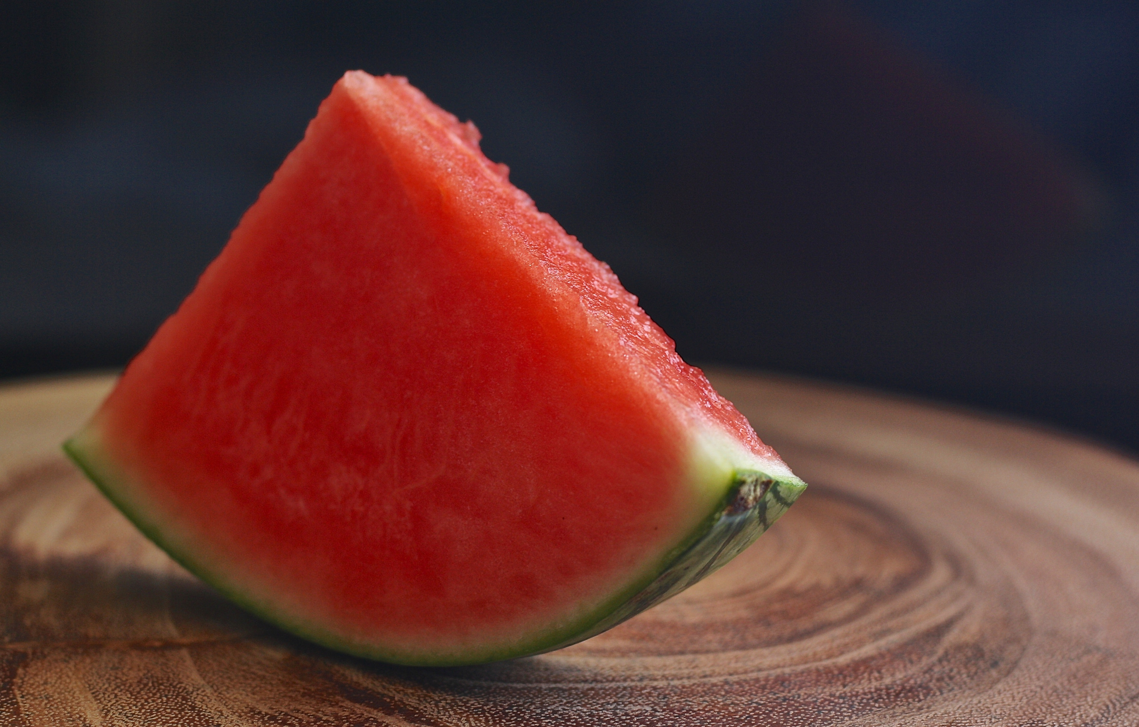
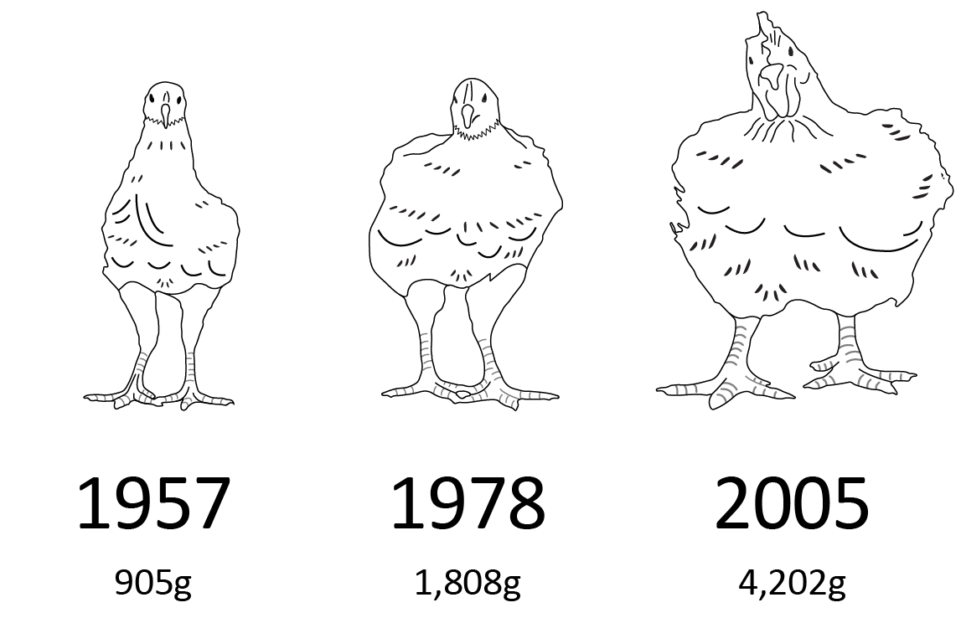
Positives of artificial selection
It can provide an improvement to plants and animals. Fruits can become seedless, vegetables can taste better, yields can be higher. Animals can be bred to produce more meat or have a specific appearance.
New plant and animal varieties can be created. For example, rice. In the wild, when you touch rice, the seeds fall off. Domestic rice has been bred to hold onto seeds so a tractor can collect it. This is for human benefit.
Future generations of plants and animals can maintain the improvements of their parents.
Source: Pixabay

Slide 8
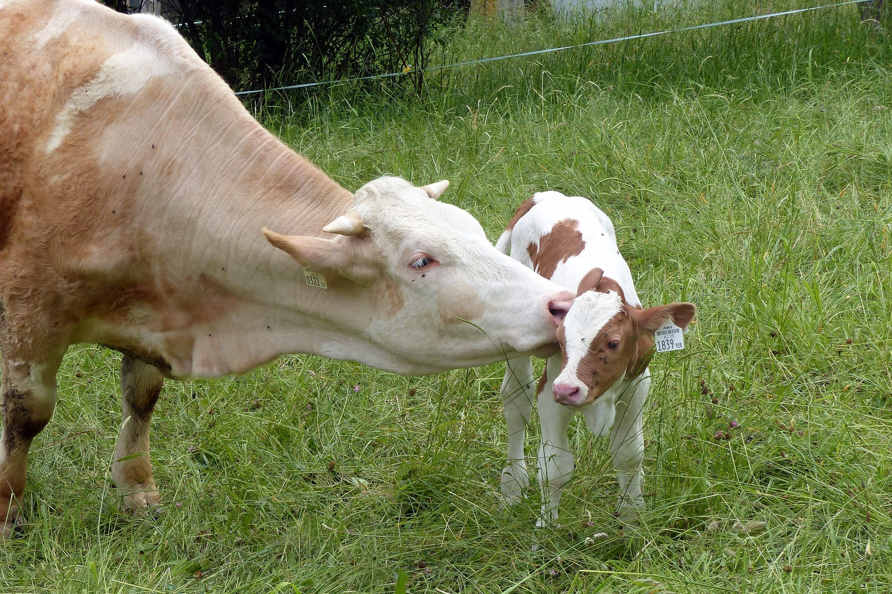
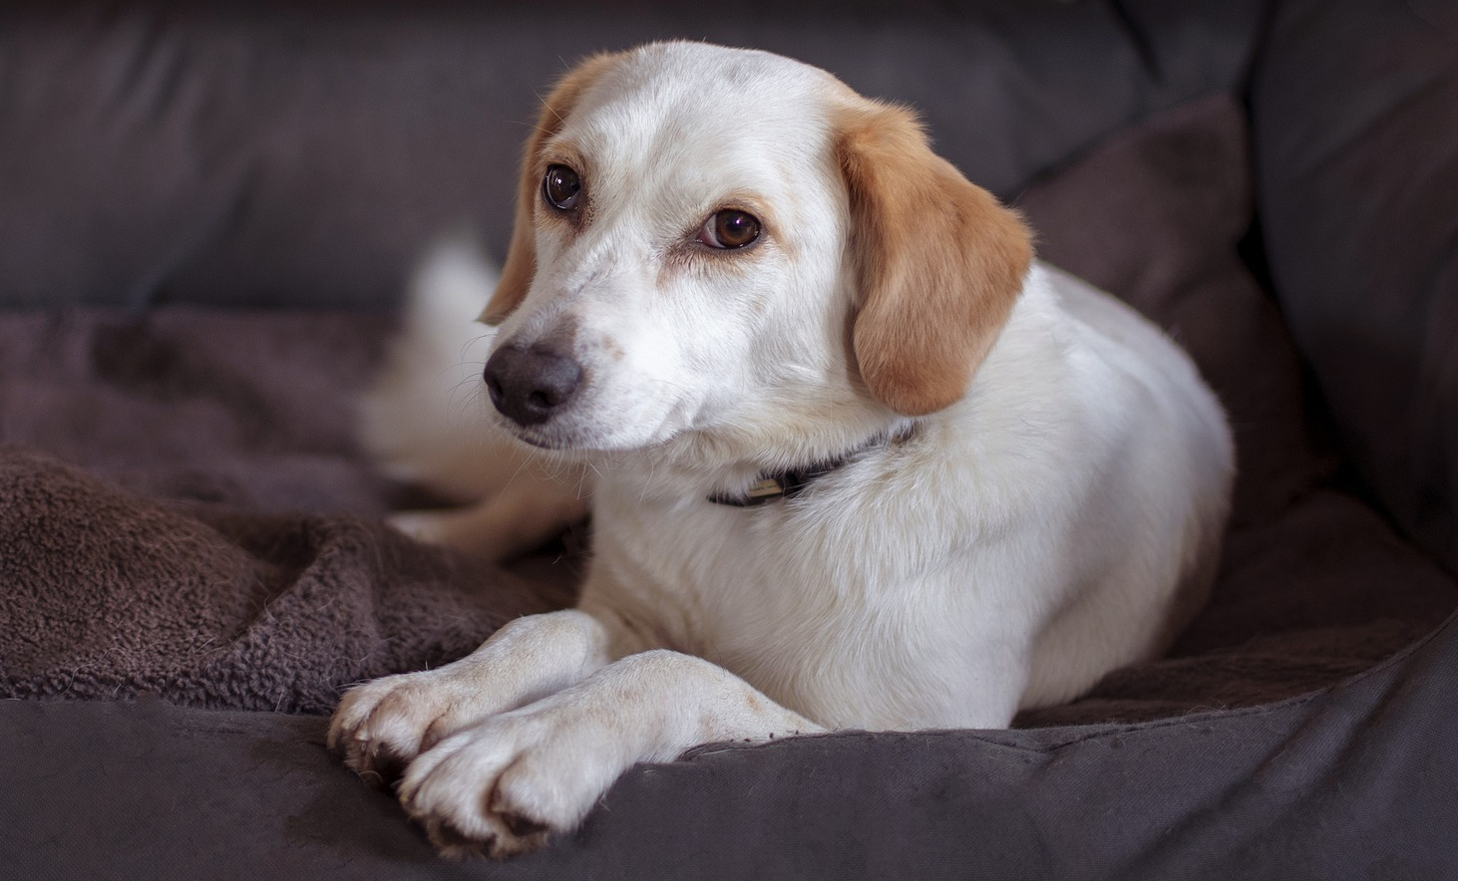
Negatives of artificial selection
It may lead to a lack of variety in plant and animal species – selective breeding can lead to in-breeding.
Genetic mutations could make the process useless and not guarantee the desired outcome.
It may end up harming animals. For example, cows have been bred to produce more meat, however their small legs may mean it could struggle to support itself.
There is no guarantee that desired traits will pass to the offspring.
Source: Pixabay
Source: Pixabay

Slide 9
Video
Watch the video about artificial selection and answer the questions below. The answers will be on the next slide.
What were some of the positives associated with artificial selection?
What were some of the negatives associated with artificial selection?
Source: Selective Breeding | Evolution | Biology on YouTube (Fuse School – Global Education, 2017)
For your safety, watch this video in the slideshow without accessing YouTube.

Slide 10
Answers
What were some of the positives associated with artificial selection?
In the early days, it meant less hunting and gathering for food. A wider variety of foods became available. Settlements began to grow, and food was able to cater for this increase.
What were some of the negatives associated with artificial selection? Inbreeding can mean offspring are too similar and can be susceptible to diseases. Reduced gene pool can mean less chance to adapt to the environment. Genetic diseases are increased.

Slide 11
Summary
Artificial selection has both positive and negative effects. Positive effects include greater improvements in plants and animals to allow our population to survive. Negative effects include increased risk of genetic diseases.

Slide 12
Challenge
Artificial selection is different from natural selection. Investigate and make note of one difference between the two. We will explore this in the next lesson.

