Slide 1
Year 10 Science
Origins of the universe
Lesson 12 – the universe and light waves

Slide 3
Get ready
You will need:
pen or pencil
paper or a notebook
a digital device.

Slide 4
Lesson review
Purpose
Qualitative (rich and deep)
Case study; ethnographies
Quantitative
Experimental and quasi-experimental
Descriptive and correlational
All underpinned by rigorous ethical standards.

Slide 5
Challenge solutions
Materials: Two sticks, two steel rules, two protractors and smart phone. | Key safety and ethical considerations: Rigour – make sure to measure shadows at exactly the same time. Take photos to be sure.
Method (describe what you would do to test your hypothesis): Place the sticks in different locations, for example, one in Adelaide and one at a friend’s house in Port Pirie. When the sun is overhead in Pt Pirie, measure shadow length (0). Measure shadow length in Adelaide and then compare and analyse.

Slide 6
Learning intention
To understand how light waves move through the universe.

Slide 7
Revision of key terms
Term | Definition
Star | A celestial object that produces its own energy through nuclear fusion.
Wavelength | The distance between successive troughs or crests in a series of waves.
Frequency | The number of times an event occurs in a unit of time. When defining wave frequency, waves are measured in numbers passing a certain point in one second, or hertz (Hz).
Source: Glossary terms from the Australian Curriculum website, viewed 20 April 2022. Australian Curriculum material is licensed under CC BY 4.0. Version updates are tracked in the ‘Curriculum version history’ section on the 'About the Australian Curriculum' page of the Australian Curriculum website.

Slide 8
BDA activities
 | Your notes
Before
During
After
A BDA (Before, During, After) activity helps you to engage deeply with a text and comprehend it at a better level.
Copy the organiser to the right to support you to:
identify what you know
make notes as you go
identify explicit, key ideas.

Slide 9
The universe
When you think of “the universe”, what are your first 3 ideas?
Perhaps you might think about 3 things that are “in” the universe.
Broaden your thinking. For example, instead of ‘stars’, think about what you actually know about stars.
Think of 3 ideas, and write them down in the ‘before’ row of the organiser you copied from last slide.
When you are finished, pause and reflect on those ideas.

Slide 10
Knowledge check: the universe
You might have mentioned or thought of the following key terms:
Reflect on those ideas.
Did you write down what you think exists as or composes the universe? If not, add that to your notes.
red giant | dwarf star | black hole
nebula | Big Bang theory | Steady State theory
red/blue shift | Doppler effect | Hubble telescope

Slide 11
What is the universe?
Make note as you view the video in the next slide.
Define the terms:
observable universe
the Universe.
How old is the universe?
Explain why it is so hard to define what is in the universe.
What are three things we know are in the universe?
Write your answers in the ‘during’ row of your organiser, pausing the video as necessary.

Slide 12
What is The Universe?
When finished viewing this video, please return to your slideshow lesson.
Watch What is the Universe? on YouTube (minutephysics, 2013, 00:00 - 02:15)

Slide 13
Knowledge check: what is the universe?
The word ‘universe’ informally means everything that is.
Note that in science, capitals are used for ‘the Universe’ in this context.
Term | Definition
The observable universe | The region of the universe that we are able to confirm or observe, in practise or in principle.
The Universe | Everything that has, can or does exist, even if we do not know it yet.

Slide 14
Knowledge check: what is the universe?
How old is the universe? About 13.8 billion years old.
Explain why it is so hard to define what is in the universe. Light takes time to travel through space, and so it takes time for us to be able to see and observe much of what exists but is quite far away.
What are 3 things we know are in the universe? The 3 things in the universe are:
Space time
Particles
The physical laws that explain how those particles interact.
Add any clarifying notes to the ‘after’ section of your BDA organiser.

Slide 15
Stars and nuclear fusion
In the vocabulary list, a star is defined as a celestial object that produces its own energy through nuclear fusion.
To build your understanding of this term, think about what is in the nucleus of an atom. That is:
electrically positive protons
electrically neutral neutrons.
In your notes write a definition of nuclear fusion.

Slide 16
Knowledge check: nuclear fusion
Term | Definition
Nuclear Fusion | A nuclear reaction in which 2 or more atomic nuclei collide at extremely high speed and join to form a new type of element, releasing a huge amount of energy.
Check and clarify your definition if necessary.
In your notes, draw an image to show or explain what stars look like.

Slide 17
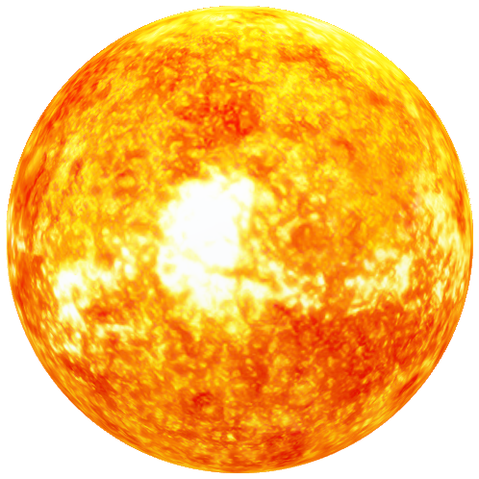
Stars and planets
You may have drawn stars that look like this:
However, stars do not have points. They are not ‘star’ shaped or even diamond shaped.
Stars are depicted as shown as they are so far away, (except for our Sun) and seem so small that our eyes see them as having points.
Actually, stars look more like this:
Images source: Microsoft 365 Image Library

Slide 18
Light
We learn about light waves when we learn about sound waves. However, there are key differences:
sound waves are longitudinal waves – the vibrations are in the same direction of travel as the wave
light waves act like transverse waves – the vibrations are at right angles to the travel of the wave.
Light is electro-magnetic radiation. It acts like a wave and a particle.
View the video on the next slide. In your notes, record one way that light acts like a wave, and one way that it acts like a particle.
Images Source: Department for Education, the Government of South Australia.

Slide 19
Light acts like a particle and a wave
For your safety, watch this video in this slideshow.
Source: Is light a particle or a wave? - Colm Kelleher on YouTube (TED-Ed, 2013)

Slide 20
Knowledge check
Record one way in which light acts like a wave, and one way that it acts like a particle.
Waves | Particles
When 2 patterns of light occupy the same space, they cause interference patterns. These are the complicated undulations that happen when 2 waves occupy the same space. | When light is shined onto a surface and transfers energy, it does this in discrete packets or ‘quanta’, which are called ‘photons’. Learn more at Las Cumbres Observatory

Slide 21
Wavelength and frequency
All different kinds of lights act like waves but have different wavelengths and frequencies.
Our eyes can only see a small part of the full spectrum of light.
Different kinds of light that are invisible to the eye include:
radio waves
x-rays
microwaves.
The size of the wave is called the wavelength. The frequency is how often that wave pattern repeats.

Slide 22
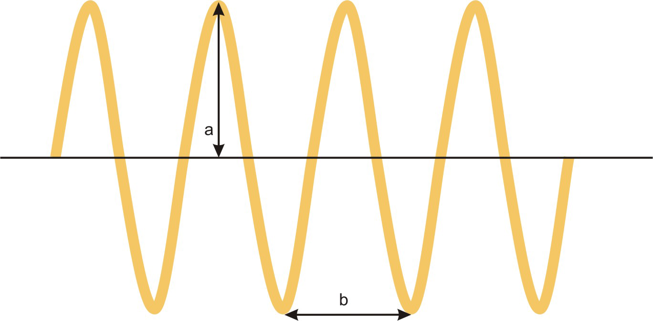
Wavelength and frequency
Using metaphors, for example, like comparing waves in light with waves in the ocean, can help to remember complex technical definitions, including:
wavelength (b)
amplitude (a)
frequency (the number of waves (b) that pass a point in a period of time).
Images source: Microsoft 365 Image Library (ocean waves), Source: Amplitude and wavelength by Sharon Bewick on <https://upload.wikimedia.org/wikipedia/commons/6/66/Amplitude_and_wavelength.png> [CC BY-SA 3.0] (teddy bears and teacher)

Slide 23
Wavelength and energy
If you know the wavelength or frequency of a light wave, you can calculate the energy.
Long wavelengths have higher energy, while short wavelengths have lower energy.
Our eyes can only see a small part of the full spectrum of light.
Different kinds of light (invisible to the eye) that exist include:
radio waves
x-rays
microwaves.

Slide 24
Types of waves
Wavelength is how we distinguish and categorise the different types of light:
radio waves have long wavelengths
visible light has a medium wavelength
x-rays have short wavelengths.
View the video on the next slide. As you go, check the accuracy of your notes and your understanding of the key points learned so far.
In your notes record how we can use our understanding of light to learn more about the universe.

Slide 25
Light waves: visible and invisible
For your safety, watch this video in this slideshow.
Source: Light waves, visible and invisible - Lucianne Walkowicz on YouTube (TED-Ed, 2014)

Slide 26
Knowledge check
The universe gives the full spectrum of light.
The Hubble Telescope, and some other 20 telescopes in orbit, can see the full spectrum of light and help us to observe distant space.
The physics of how different wavelengths work on Earth is the same as how they work in space. We can:
use this information to calculate what is happening in space from our data
identify the elements and types of energy that exist in distant galaxies.

Slide 27
Summary
Light is electromagnetic radiation, categorised by wavelength.
If you know the wavelength or frequency of a light wave, you can calculate the energy. You need to know:
the size of a light wave is the wavelength
the frequency of a light wave is how often that wave pattern repeats
long wavelengths have low energy while short wavelengths have high energy.
We can use our understanding of light on Earth to learn about the types of energy and components of distant galaxies by measuring the light we observe.

Slide 28
Challenge
Arizona State University has a webpage called, ‘Ask a Biologist’, where users can request information from biology experts.
In the video on light waves, we learnt that the wavelength of light determines if we can see it, and how cells called rods and cones help us to perceive light.
This is an example of how biology and physics interact.
Read how rods and Cones work.
In your notes explain what happens to our vision when we are looking at things in low light.

