Slide 1

Year 10 Science
Origins of the universe
Lesson 13 – speed of light

Slide 3
Get ready
You will need:
pen or pencil
paper or a notebook
a digital device.

Slide 4
Lesson review
Light is electromagnetic radiation, categorised by wavelength.
If you know the wavelength or frequency of a light wave, you can calculate the energy. Remember:
the size of a light wave is the wavelength
the frequency of a light wave is how often that wave pattern repeats
long wavelengths have low energy; short wavelengths have high energy.
We can use our understanding of light on Earth to learn about the types of energy and components of distant galaxies by measuring the light we observe.

Slide 5

Challenge solutions
Enhanced scientific knowledge
Biology
Physics
Psychology
In the challenge, you read how specialised photosensitive cells (rods and cones) work in our eyes.
What happens when we are looking at things in low light?
Rods can detect light at low levels, but do not detect colour. Therefore we see in shades of grey.
This makes our perception of colour at night unreliable.
Images source: Pixabay (leaves), Source: Amplitude and wavelength by Sharon Bewick on <https://upload.wikimedia.org/wikipedia/commons/6/66/Amplitude_and_wavelength.png> [CC BY-SA 3.0] (teddy bears and teacher)

Slide 6
Learning intention
To calculate the speed of light.

Slide 7
Key terms
Term | Definition
Microwaves | Waves in the electro-magnetic spectrum between the frequencies of about 300 and 300 000 MHz.
Scientific notation | A way of writing very large or very small numbers using powers of ten.
Source: Glossary terms from the Australian Curriculum website, viewed 20 April 2022. Australian Curriculum material is licensed under CC BY 4.0. Version updates are tracked in the ‘Curriculum version history’ section on the 'About the Australian Curriculum' page of the Australian Curriculum website.

Slide 8
Light waves
All light has a wave form. The difference between types of light are their respective wavelengths.
A microwave is light that we cannot see, and they have applications that include warming up our food.
Can you recall some of the characteristics of waves?
Copy the image and label the wave.
Source: Department for Education, the Government of South Australia

Slide 9
Knowledge check
Wavelength
Amplitude
Centre line or midpoint
Source: Department for Education, the Government of South Australia

Slide 10
Microwaves
Microwaves (the machines) use microwaves (the light) to heat food.
They do so by exciting the water molecules within food, therefore the wavelength of the microwave is tuned specifically to water.
As the water is excited by the waves, friction is created, and the food then heats up.
Write the answer to the following question in your notes:
Is your food hot all the way through when cooked in the microwave?

Slide 11
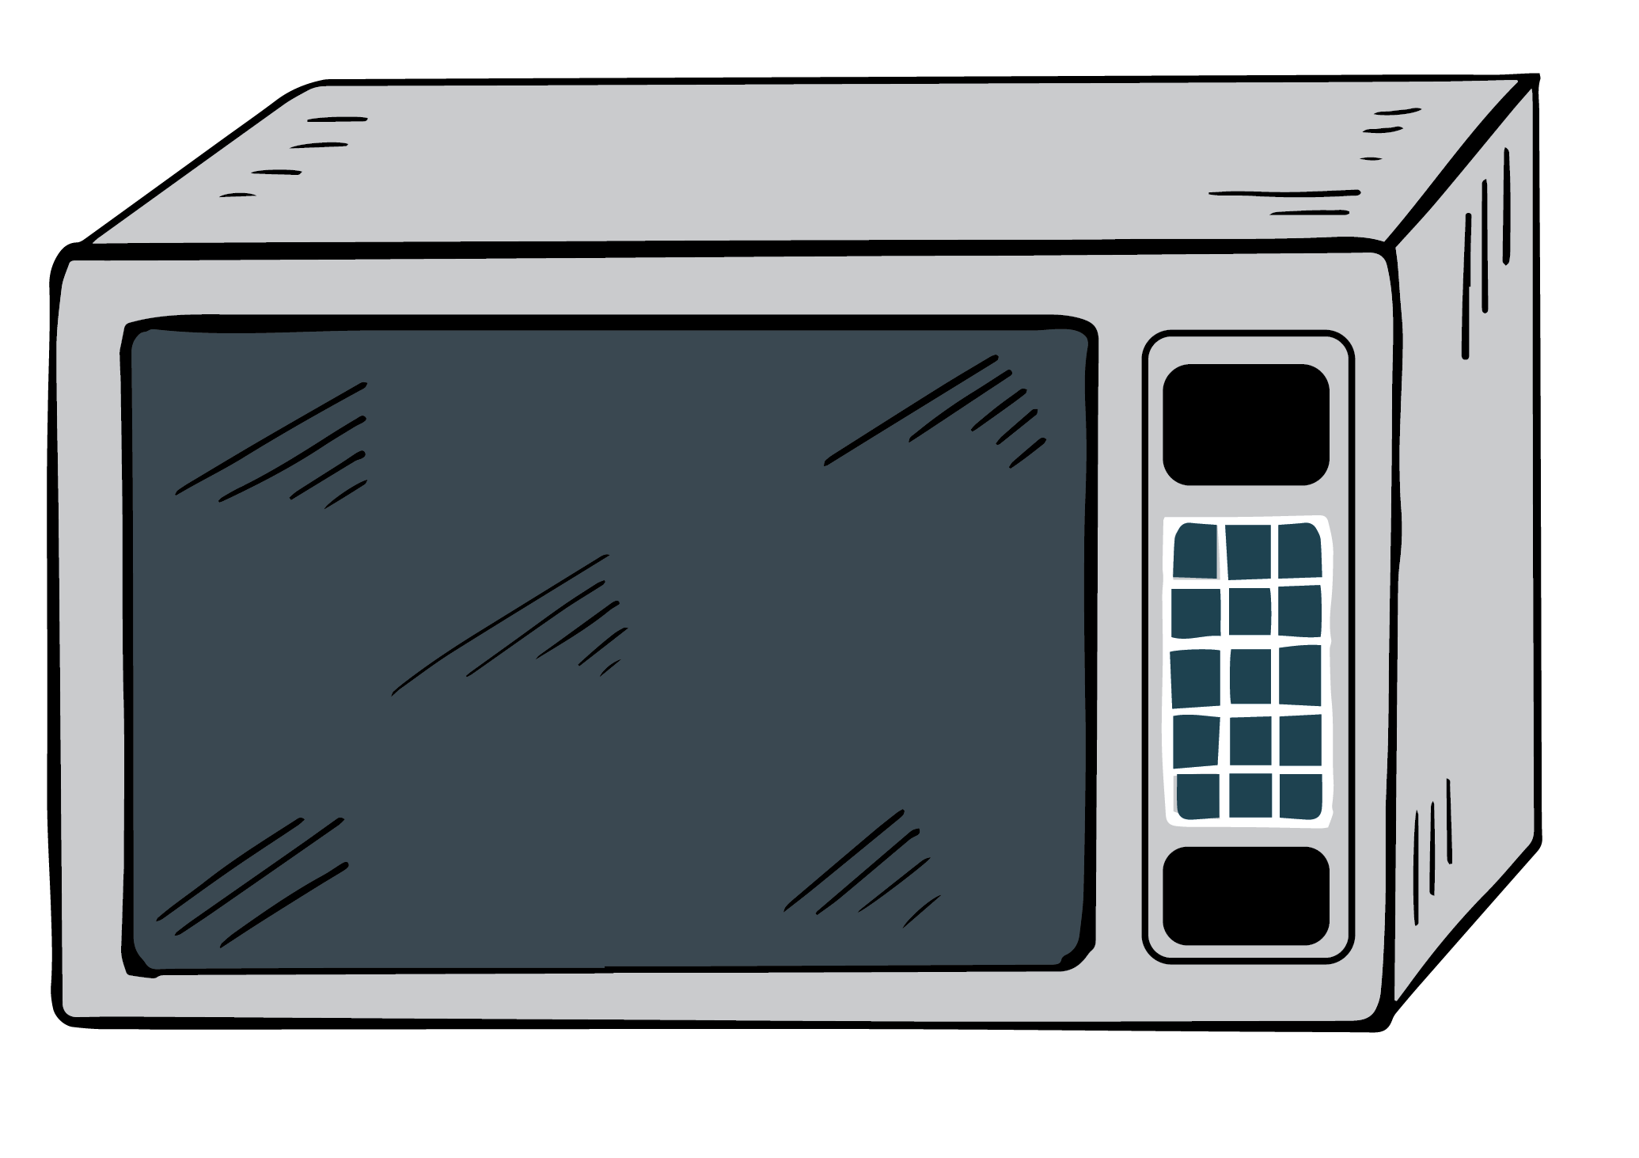
Knowledge check
Is your food hot all the way through when cooked in the microwave? No! Sometimes there are cold spots and hot spots on the food.
The hot parts are where the antinodes are situated.
The cold parts are where the nodes are situated.
Source: Department for Education, the Government of South Australia

Slide 12
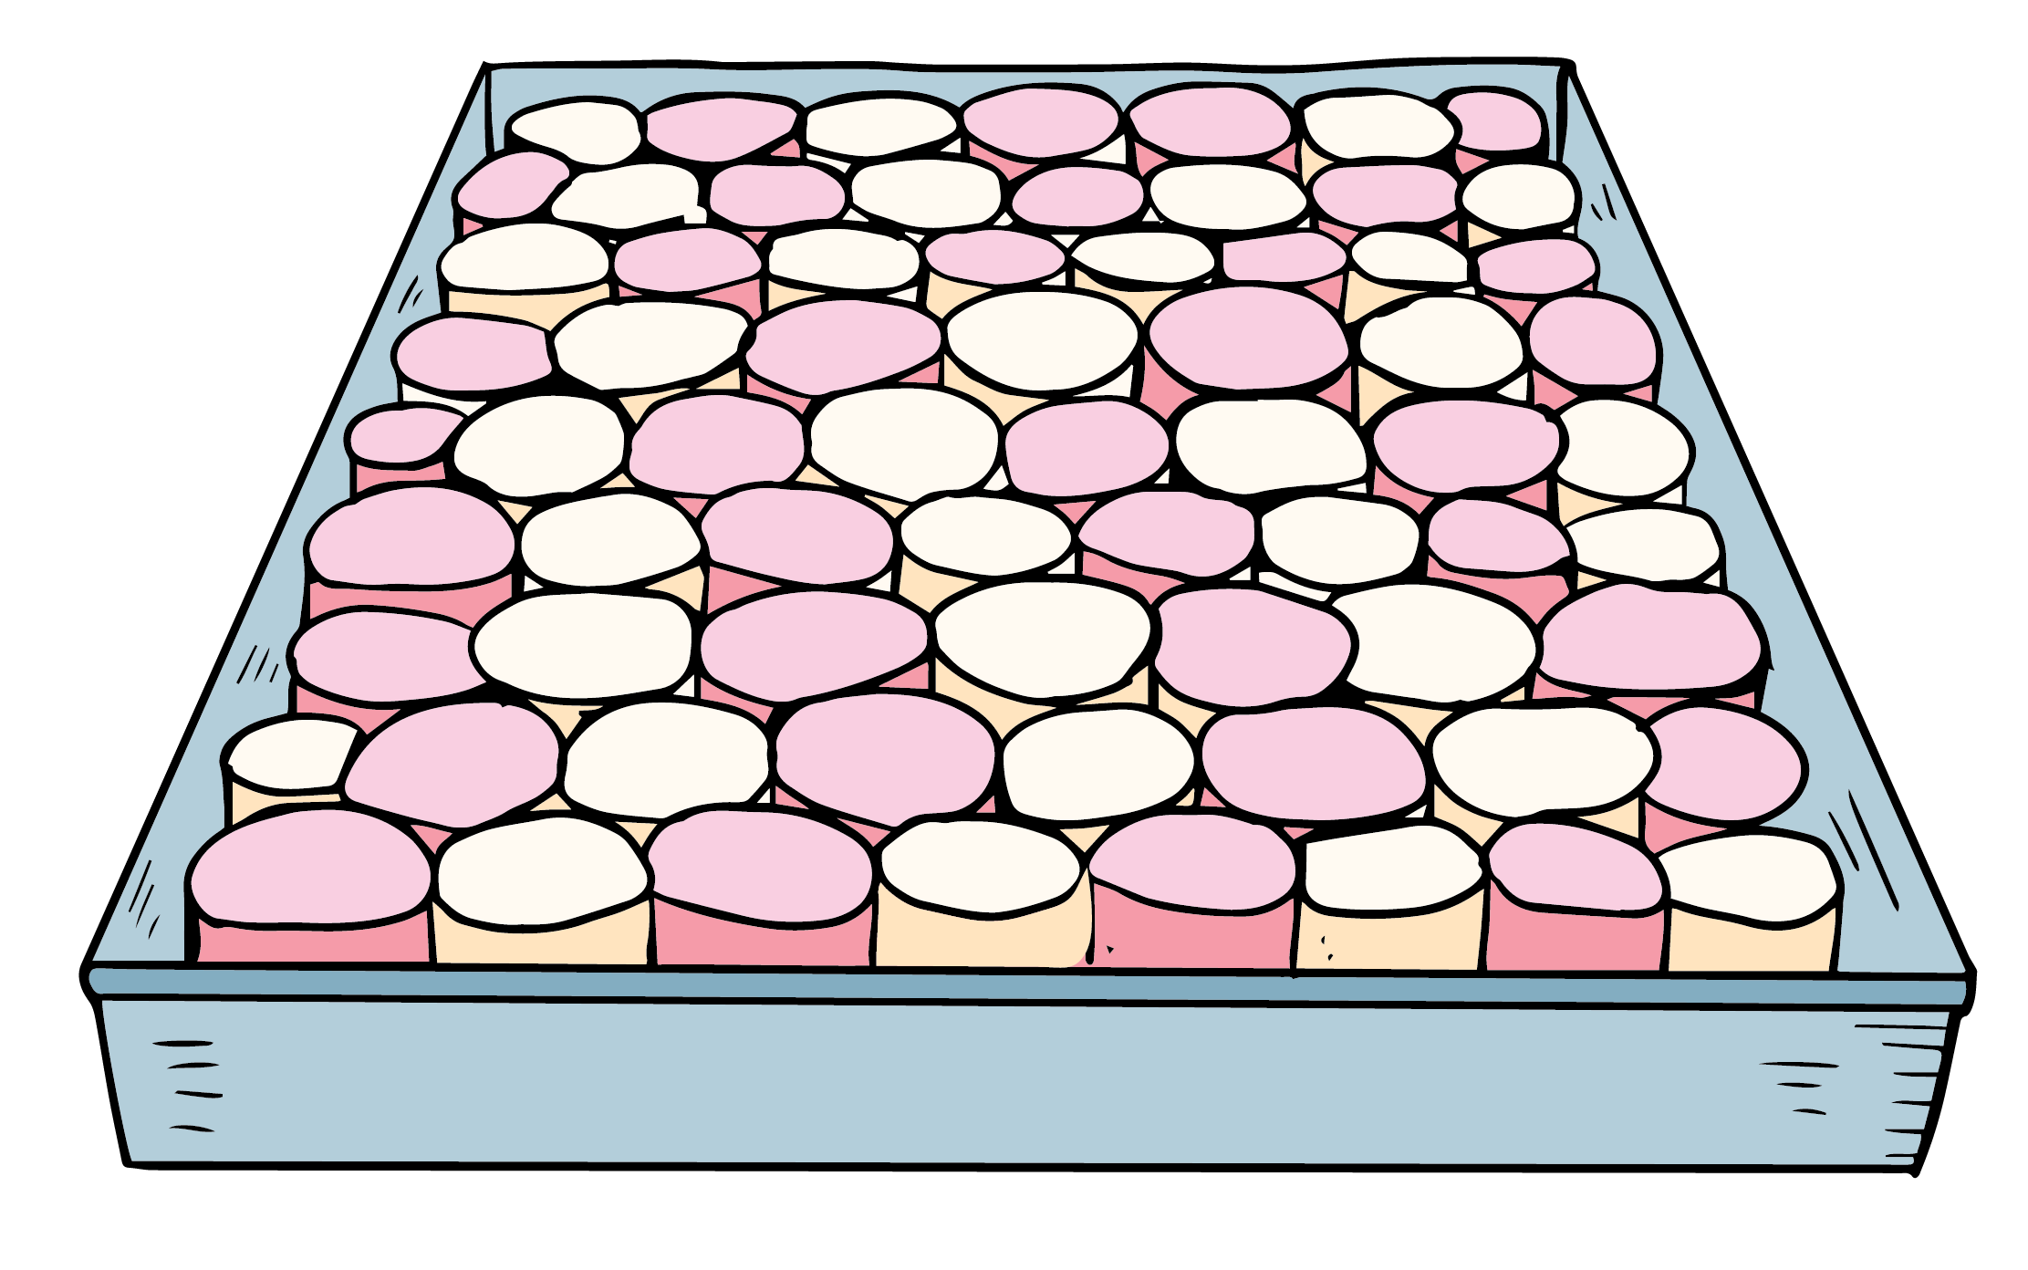
Modelling the speed of light
You can model the speed of light using marshmallows:
Evenly spread marshmallows on a microwave safe plate.
Remove the microwave turntable (and rotor).
Source: Department for Education, the Government of South Australia

Slide 13
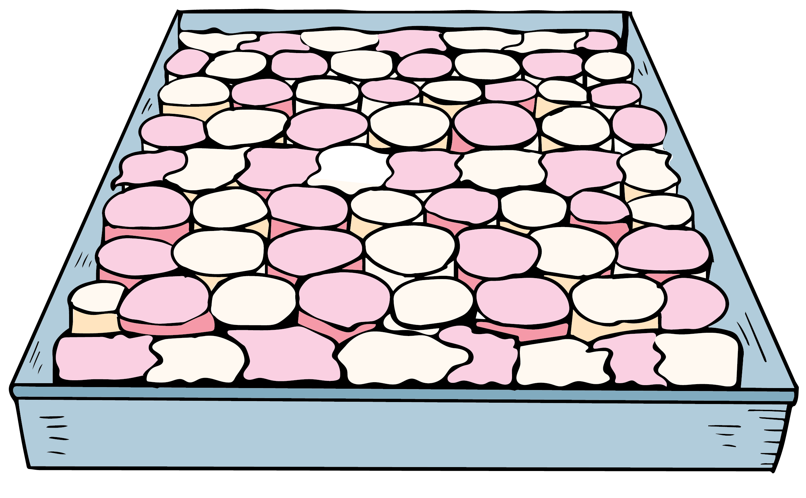
Modelling the speed of light
Place the plate in the microwave and microwave the marshmallows for approximately 10 seconds.
If no marshmallows have melted, melt for a further 10 seconds. Repeat if necessary.
You will notice patterns of melted and unmelted marshmallows.
Mark these as ‘antinodes’.

Slide 14
Modelling the speed of light

Slide 15
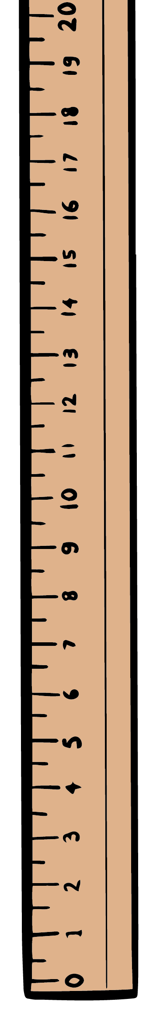
Modelling the speed of light
Measure the distance in metres between two antinodes, or two points of melted marshmallows.
This is half the wavelength of a microwave.
Double it and you have the wavelength of the microwave.

Slide 16
Calculating the speed of light
The distance between antinodes is 6cm.
Double it to calculate the wavelength of the microwave.
Convert that to meters using scientific notation.
Write your answer in your books or on a digital device.
This is the wavelength of a microwave.

Slide 17

Calculating the speed of light
When finished viewing this video, please return to your slideshow lesson.
Watch Scientific Notation (An introduction) on YouTube (MooMooMath and Science, 2018, 00:00-02:04)

Slide 18
Knowledge check
The distance between antinodes is 6cm.
Double it to calculate the wavelength of the microwave.
6 cm x 2 = 12 cm
Convert that to meters using scientific notation.
12 cm = 0.12 meters
= 1.2 x 10⁻¹ m.

Slide 19
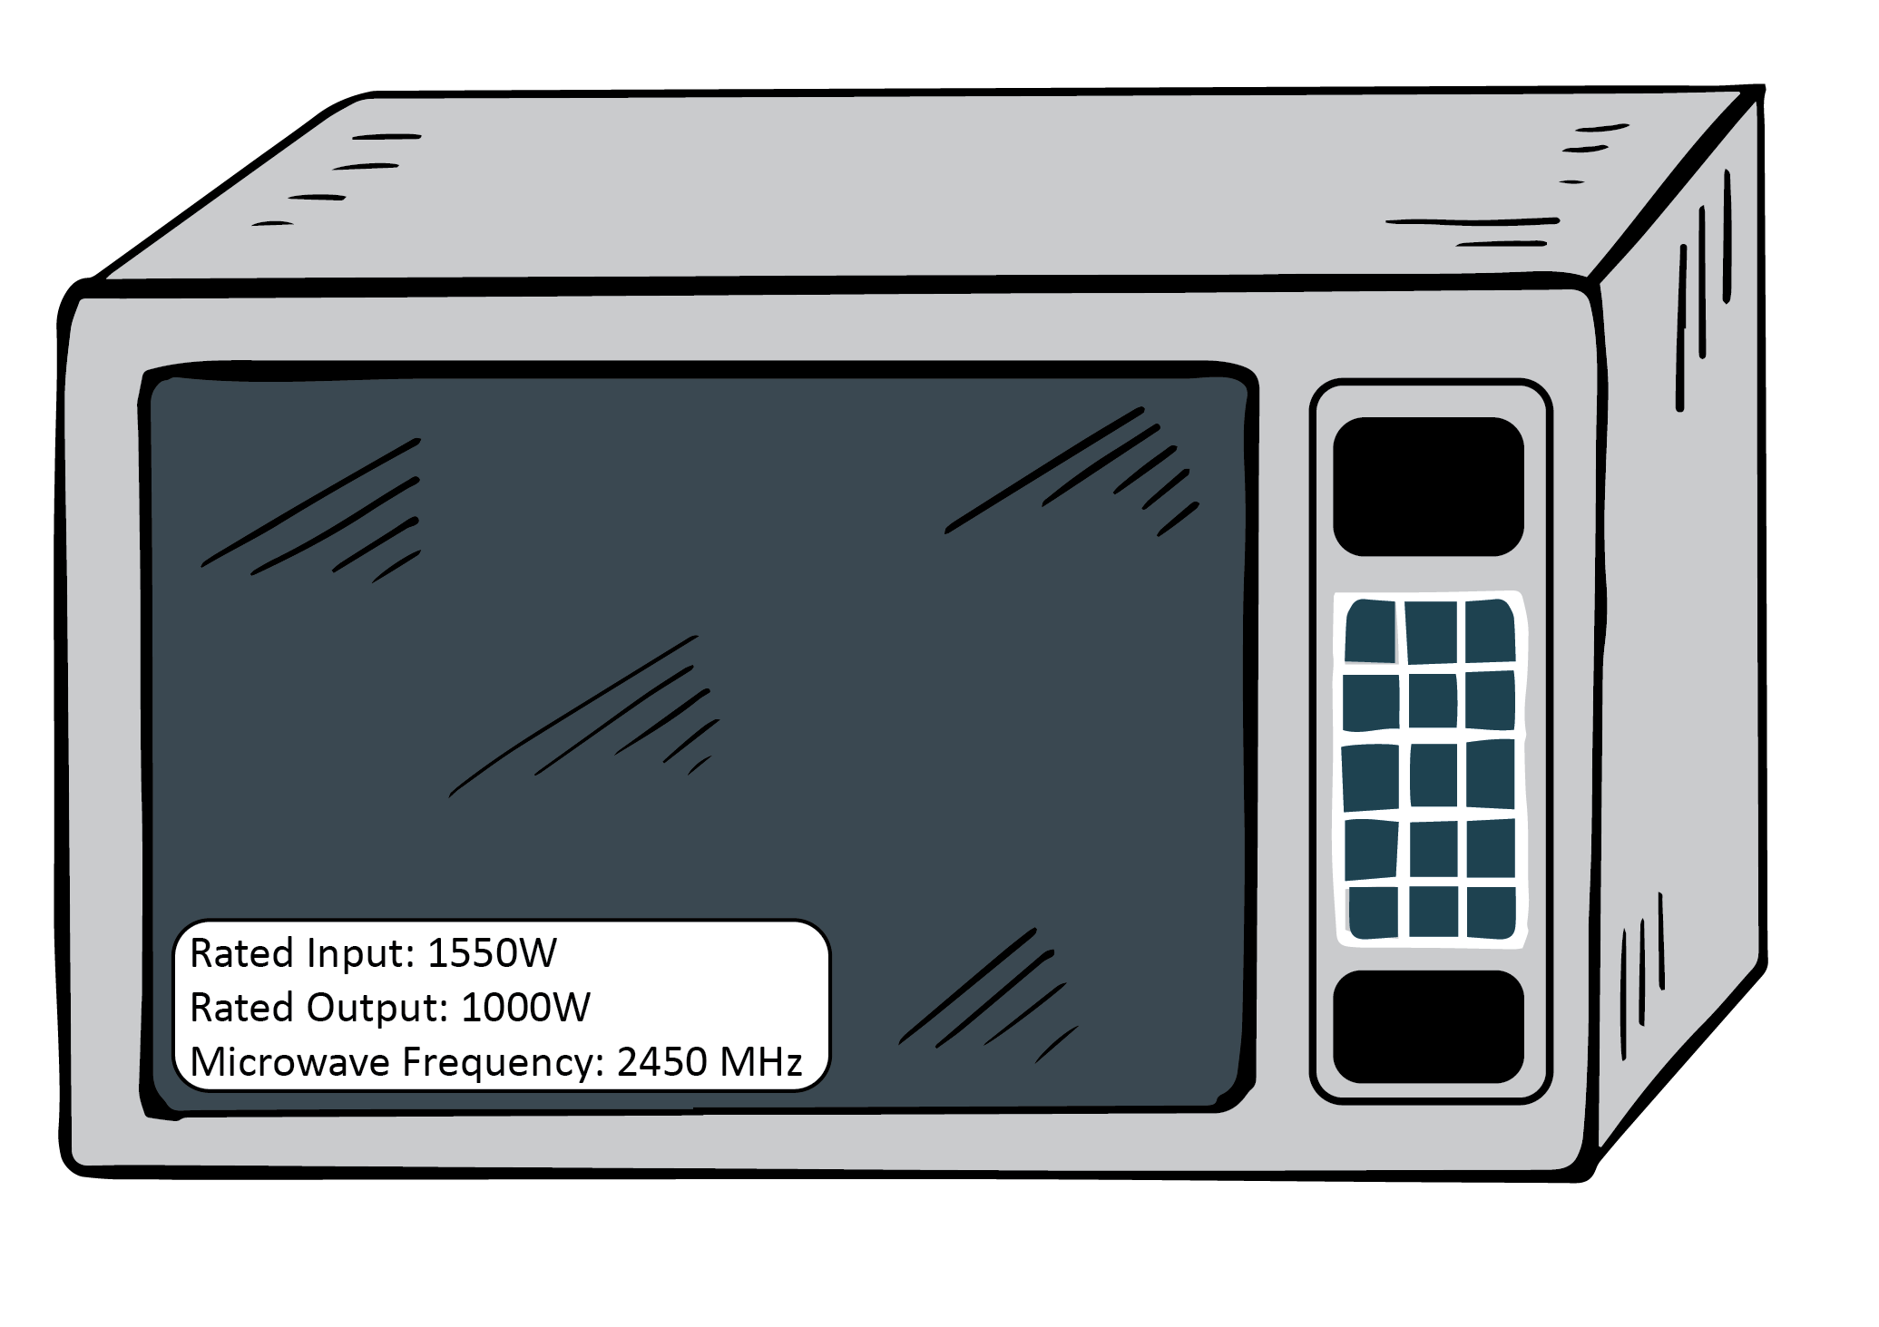
Calculating the speed of light
Each microwave has an operating frequency of the microwave.
It is usually 2450MHz.
Mega means million.
Herz means ‘per second’.
That is: 2,450 million meters per second.
Convert 2,450,000,000 meters per second using scientific notation.

Slide 20
Knowledge check
Convert 2,450,000,000 meters per second using scientific notation.
2,450,000,000 meters per second
= 2.45 x 10⁹ meters per second

Slide 21
Wave equation
The formula that is used to calculate the speed of a wave is called the ‘wave equation’.
Wave equation: 𝑣 = 𝑓 𝜆
𝑣=𝑣𝑒𝑙𝑜𝑐𝑖𝑡𝑦 𝑜𝑓 𝑤𝑎𝑣𝑒 𝑓=𝑓𝑟𝑒𝑞𝑢𝑒𝑛𝑐𝑦 𝑎𝑛𝑑 𝜆=𝑤𝑎𝑣𝑒𝑙𝑒𝑛𝑔𝑡ℎ
To calculate the velocity, or speed of a wave, multiple the frequency by the wavelength.
Multiply the wavelength of the microwave by the frequency.

Slide 22
Knowledge check
Multiply the wavelength of the microwave by the frequency.
1.2 x 10⁻¹ x 2.45 x 10⁹
= 1.2 x 2.45 x 10⁹ x 10⁻¹
= 2.94 x 10⁸ m/s
2.94
10⁸

Slide 23
Summary
The speed of light is the fastest attainable speed known in the universe.
The speed of a wave can be calculated using the ‘wave equation’.
Because light acts like a wave, the speed of light can be calculated using the wave equation – provided we know the wavelength and frequency.
Scientific notation can be used to record very large or very small numbers.
The speed of light is 3 x 10⁸ m/s.

Slide 24
Challenge
One light year is the distance light travels in one year (let’s assume a non-leap year).
Calculate the distance that light travels in one year.
Hint:
Start by using the speed of light value (3 x 10⁸ ).
Multiply that number by 60 to know how far light travels in a minute.

