Slide 1
Year 10 Science
Origins of the universe
Lesson 14 – measuring spectra

Slide 3
Get ready
You will need:
pen or pencil
paper or a notebook
a digital device.

Slide 4
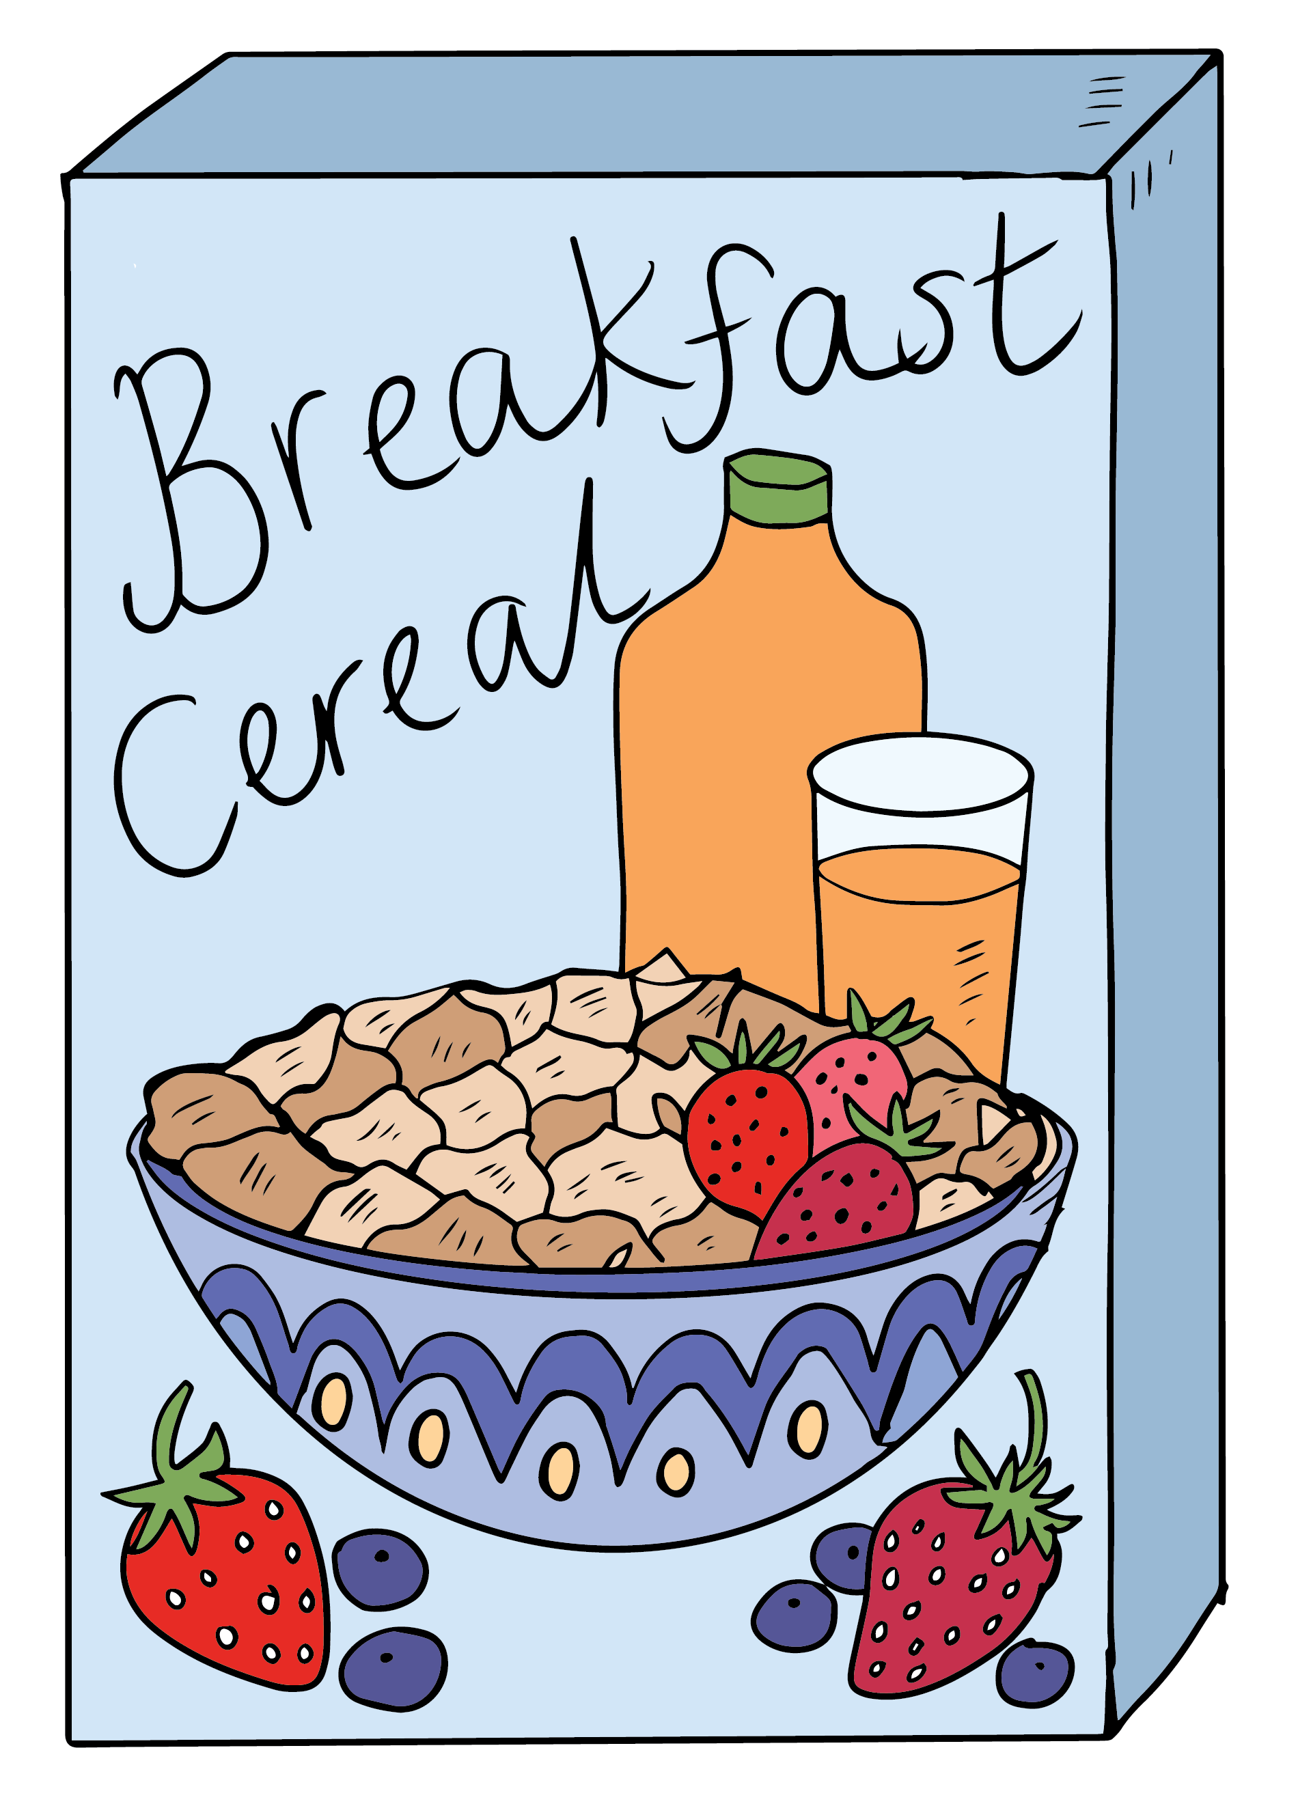
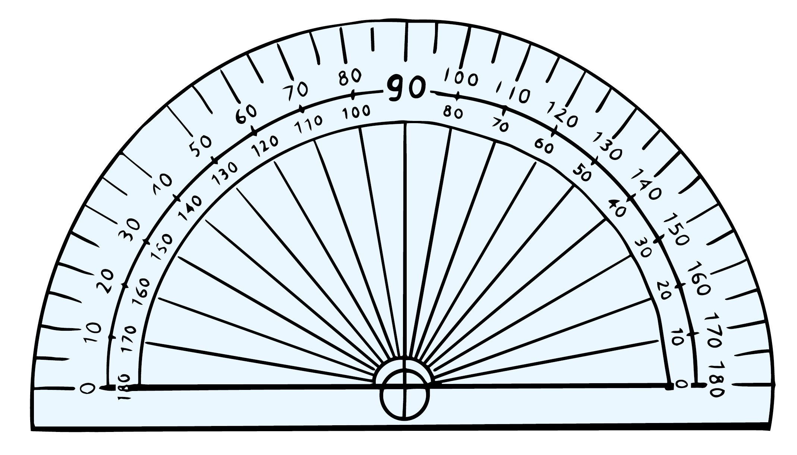
Get ready
To build a spectrometer, you will need:
a cardboard box (a cereal box or a cardboard roll)
scissors
a CD
protractor
ruler
coloured pencils.
Source: Department for Education, the Government of South Australia

Slide 5
Lesson review
The speed of light is the fastest attainable speed known in the universe.
We can calculate the speed of a wave using the ‘wave equation’.
Because light acts like a wave, we can calculate the speed of light using the wave equation, provided we know the wavelength and frequency.
We can use scientific notation to record very large or very small numbers.
The speed of light is 3 x 10⁸ m/s.

Slide 6
Challenge solutions
Calculate the distance that light travels in one year.
Speed of light value = 3 x 10⁸ m/s
Convert to minutes x 60 = 180 x 10⁸ m
Convert to hours x 60 = 10,800 x 10⁸ m
Convert to days x 24 = 259,200 x 10⁸ m
Convert to years x 365 = 94,608,000 x 10⁸ m
Convert to scientific notation = 9.46 x 10⁷ x 10⁸ m = 9.46x10¹⁵ meters.
Light travels 9.46x10¹⁵ meters in one year.

Slide 7
Learning intention
To analyse patterns of spectra using a spectrometer.

Slide 8
Key terms
Term | Definition
Electromagnetic spectrum | The range of wavelengths, or frequencies, over which electromagnetic radiation extends.
Dispersion | The separation of white light into colours, or of any radiation, according to wavelength.

Slide 9
Spectrometers
A spectrometer is a device that separates the electromagnetic spectrum and measures the wavelength of the separated components to identify elements. It comes from the terms:
spectro – optical spectrum
meter – to measure.
The spectrum includes all invisible and visible light.
The spectrometer modelled in this lesson will only separate visible light.
We will then learn how scientists analyse emission spectras to learn more about different sources of light in the universe.

Slide 10
Building a spectrometer
The spectrometer that you will build in this lesson can be used to look at a variety of light sources. These include:
light bulbs (halogen, fluorescent, incandescent)
torch from a phone
computer screen
diffused sunlight through a window.
Do NOT stare into the Sun with your eyes.
You can then draw emission spectras and compare them with known emission spectras to identify light sources and the elements within those sources.

Slide 11
Compact disc formats
The composition of a compact disc (CD) being both a mirror and a reflective coating, gives it special light reflecting properties:
CDs capture light from the visible spectrum in the ridges where data is encoded
light diffracts (or bends) with interference patterns
the angle the CD determines how light is reflected, because it changes the size of the ridges that diffract different wavelengths of light, known as dispersion.
Why does a CD reflect rainbow colors? has a powerful simulation of how this works.
If you are building along with these instructions, ensure the CD you are using does not have sentimental value!

Slide 12
How spectrometers work
The spectrometer we will build does not measure wavelengths, but it does split visible light into emission spectra.
We can then compare the emission spectra to known patterns.
If we see identical patterns, we can then determine that different sources of light have the same elemental composition.
The moon does not generate light. It only reflects the light of the sun.
What will you observe comparing the emission spectra from the moon with that from the sun?

Slide 13
Knowledge check
The moon does not generate light. It only reflects the light of the sun. What will you observe comparing the emission spectra from the moon with that from the sun? The patterns should be identical because the light source is the same.
Spectrometers need:
an entry point for a light source
a diffraction tool (for example, a mirror)
a way to control light (to focus on what we see).
Source: Microsoft 365 Image Library

Slide 14
Building a spectrometer
Check the tools and materials needed to build a spectrometer here.
On one side of the cereal box, measure 10cm down and rule a horizontal line across the side of the box.
Using the protractor, measure a 30° line approximately 10cm long from the horizontal line, on the front and back of the cereal box.
Cut along both these lines.
10 cm down
30 degrees
30 degrees
Source: Department for Education, the Government of South Australia

Slide 15
Building a spectrometer
Insert the CD into the slit with the reflective side up.
On the side directly opposite the CD measure 10cm down and rule another horizontal line across the side of the box.
Cut a slit approximately 1cm long. This is the slit for the light source or where the light is going to enter the spectrometer.
Also 10 cm down, on side (not front) of box.
Source: Department for Education, the Government of South Australia

Slide 16
Building a spectrometer
Top of box, above CD, 2 cm by 1 cm.
At the very top of the box cut a hole approximately 2cm by 1cm.
This is the viewing hole and when you look through it, you should see the CD directly below.
Source: Department for Education, the Government of South Australia

Slide 17
Knowledge check
Source: Department for Education, the Government of South Australia

Slide 18
Using a spectrometer
In a dim room look at different light sources. Try:
different types of lights/torches at home (for example, LED, halogen)
diffused sunlight through a window
the light from your phone.
Compare the spectra emissions from two different light sources at home. If they are the same, what does this tell you about the light?

Slide 19
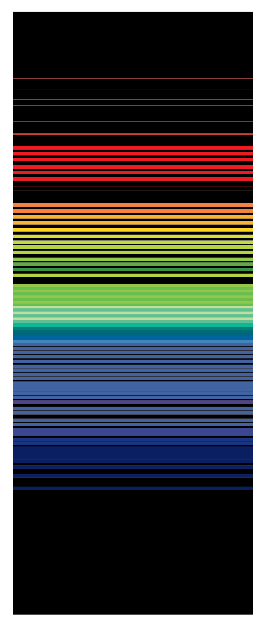
Knowledge check
If the spectra emissions from two different light sources are the same, what does this tell you about the light? This indicates they are made of the same elements.
If you know light A is a halogen light and do not know what light B is, but the spectra emissions are identical, then both are the same type of light with the same composition.
What happens when there are multiple elements in a source?
Images source: Department for Education, the Government of South Australia (Spectra diagrams), Microsoft 365 Image Library (light icons)

Slide 20
Knowledge check
When Newton first described and observed the solar spectrum, all he could see was a continuous band of colours.
In 1802, William Wollaston built an improved spectrometer and observed dark bands in the solar spectrum.
This is because all gases absorb different wavelengths of light. The pattern of absorbed and emitted light is unique to each element.
If a gas contains 2 elements, light passed through that gas show the dark band patterns for each element.
We can use these patterns to identify combinations of elements.

Slide 21
Comparing spectra
Sodium | Neon
Helium | Hydrogen
View the emission spectra of various atoms for more images.
Images source: emission spectrum of neon by Deo Favente on <https://commons.wikimedia.org/wiki/File:Neon_emission.png> [CC BY-SA 3.0], Hydrogen and helium adapted from Atomic emission spectrum of helium by Ranjithsiji on <https://commons.wikimedia.org/wiki/File:Atomic_emission_spectrum_of_helium.svg> [CC BY-SA 4.0], Sodium emission spectra Department for Education, the Government of South Australia

Slide 22
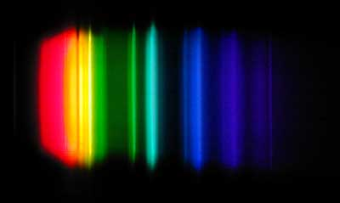
Comparing spectra
Match the light source to the spectra image each might produce:
If you could not make a spectrometer, examine the images from a CD spectrometer.
Light source | A hydrogen light bulb. | The bulb in a remote is made of neon gas. | A candle is lit with a sodium match.
Spectra image
Images source: Spectrum of a neon glow lamp by Umop503 on <https://commons.wikimedia.org/wiki/File:Neon_spectrum.png> [CC BY-SA 1.0], Visible spectrum of hydrogen by Jan Homann on <https://commons.wikimedia.org/wiki/File:Visible_spectrum_of_hydrogen.jpg> Spectrum of high pressure sodium lamp by Skatebiker on <https://commons.wikimedia.org/wiki/File:Spectrum-hp-sodium.jpg> [both images CC BY-SA 3.0].

Slide 23
Summary
You can make technical tools to examine the spectrum of light at home, recycling unwanted cardboard and CDs.
Astronomers can compare the spectrum of a celestial object or material with the spectra of known elements and molecules.
When the emission spectra of a celestial object matches known elements and molecules, astronomers can identify what the celestial object or material is made of.

Slide 24
Challenge
When you look through a spectrometer, you can see the emission spectra that is the glow of elements, producing specific colours.
However, when light passes through a gas, certain colours or wavelengths may be absorbed by atoms and molecules in the gas. The absorption of light in this case causes dark lines in the emission spectra, which are the absorption spectrum.
Compare the images of emissions spectra and absorption spectra at Spectroscopy: Absorption and Emission Spectra of Various Elements. What do you notice?

