Slide 1

Bullying prevention and response
Notes:
Notes for presenter:
Purpose of Slide 1: To introduce the parent session and the purpose of the evening
Script: We are delighted to welcome you to our bullying prevention and response information evening.
*Insert general introductions of yourself and the school

Slide 2
South Australian children and young people are thriving in safe environments that promote positive relationships, safety and wellbeing so that they can achieve their full potential.
Department for Education Bullying Prevention Strategy “Connected” – A community approach to bullying prevention within the school gates
Notes:
Notes for presenter:
Purpose of Slide 2 – Provide parents with the wider overall context as to statewide commitment to prevent bullying in South Australian schools.
Script - The statewide Bullying Prevention Strategy aims to ensure that: ‘South Australian children and young people are thriving in safe environments that promote positive relationships, safety and wellbeing so that they can achieve their full potential.’
Here at <your school’s name>, we aim to provide a learning environment where you child can thrive and achieve their personal best.
* Include your school’s vision statement or values

Slide 3
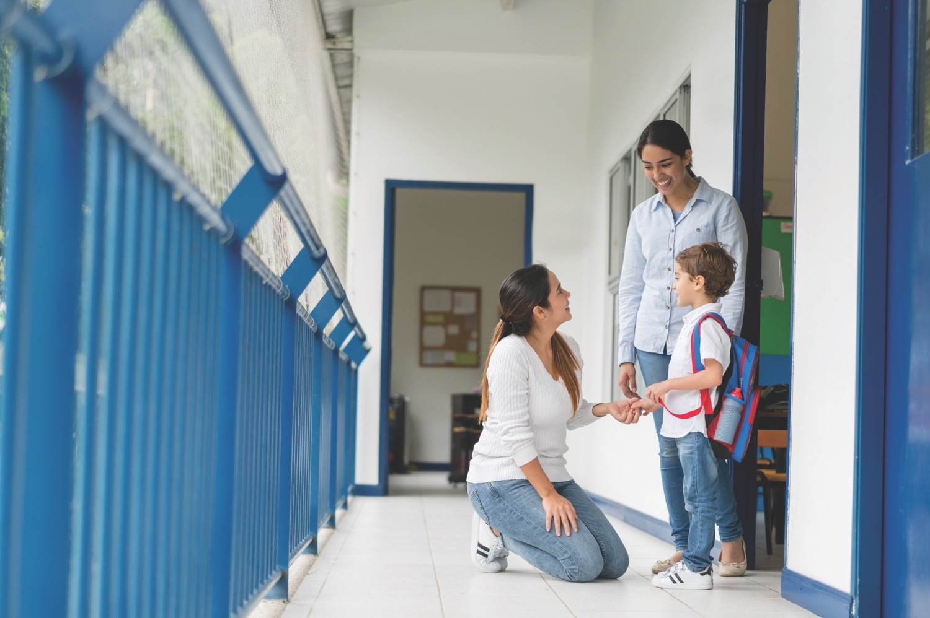
Bullying prevention
What we will cover
What is bullying?
Common bullying myths
Bullying prevention within <our school>
How do I know if my child may be experiencing bullying?
What parents can do
How our school responds to bullying?
Notes:
Notes for presenter:
Purpose of Slide 3 – Outline the content covered in the parent presentation
Script - We will be:
Defining what bullying is based on the national definition
The common bullying myths that people may hold about bullying and what research actually tells us about bullying
The ways <our school> is a creating safe and inclusive environments and preventing bullying from occurring.
How to identify if your child may be experiencing bullying
The specific things you can do to support your child
How <our school> responds to incidents of bullying

Slide 4
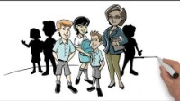
Notes:
Notes for presenter:
Purpose of Slide 3 – This clip has been used in both educator training modules and bullying prevention lessons for students. This video has been used to provide consistent information to parents, children and educators about what bullying is. This is based on the national definition and here, all parties will have the same understanding when it comes to bullying.
Script - It is important that the school, you, as parents and your children have the same understanding of what bullying is. This is to help each of us to easily identify when bullying happens and intervene appropriately.
The following video outlines the national definition of bullying, which is provided by the Australian Government’s bullying prevention initiative, Bullying. No Way!

Slide 5

National definition of bullying
Bullying is:
A misuse of power in relationships
Ongoing, repeated and deliberate set of behaviours
Hurtful and damaging to all people involved
Notes:
Notes for presenter:
Purpose of Slide 5 – Summarise the three key components of the national definition of bullying
Script - To summarise the three key components of the national definition of bullying:
Bullying is defined by:
A misuse of power in relationships
Ongoing, repeated and deliberate set of behaviours which can be verbal, physical and social. These behaviours may also occur face to face or online
AND
These behaviours have hurtful and damaging effects to all people involved which can be long-lasting.
All of these 3 components need to be present to constitute as bullying.

Slide 6
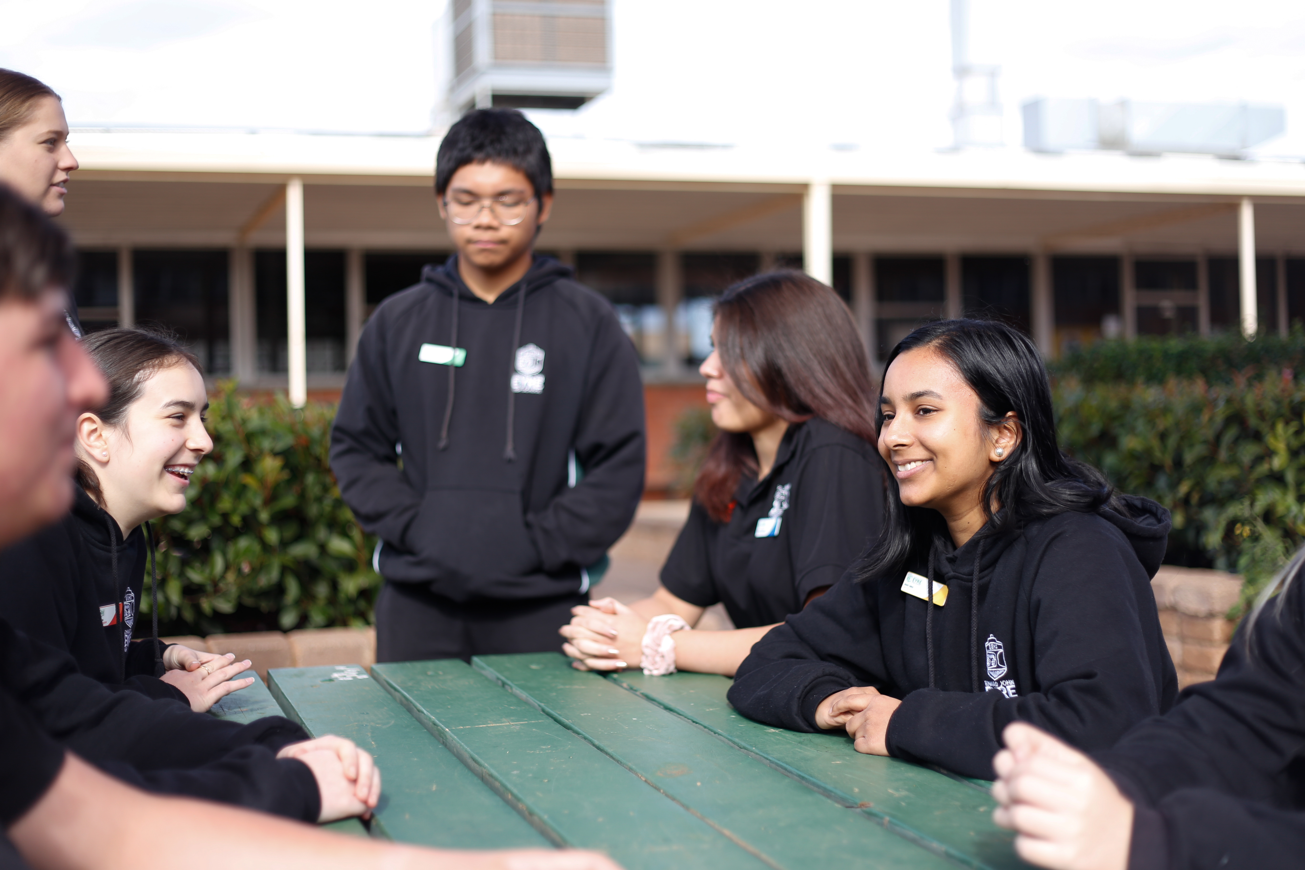
Myths about bullying
Bullying is a normal part of growing up
Just try harder to fit in
Reporting bullying will only make it worse
Just ignore them and they will go away
Bullying makes kids tougher
Bullying is easy to spot
Notes:
Notes for presenter:
Purpose of Slide 6 – Parents and educators come into the school environment with their own understanding and experiences of bullying. This impacts on how one responds to incidents of bullying and the advice given to children and young people about how to best handle the situation. Some of these beliefs are helpful and some are unhelpful, so it is important that the school can address these myths head on to ensure moving forward, parents can be on the same page when it comes to bullying and provide the best support and advice to their children.
Script - Some of the common myths about bullying include:
Bullying is ‘normal’. It’s a part of growing up and builds character and resilience. This is a common myth, which may be based on our own experiences at school.
There is a natural pecking order and prepares children for the ‘real world’. Bullying is not an effective way to build resilience, or ‘toughen up’ an individual.
Bullying is not a normal ‘rite of passage’ in school and it can have detrimental effects on a person’s mental health, self-esteem and well-being. This unfortunately may span into later life.
Ignoring or keeping quiet about bullying incidents. This is not an effective way of managing bullying situations.
Bullying may not be immediately obvious to people outside of the situation. Covert bullying can include using hand gestures, weird or threatening looks, whispering, sneaky bumps or back turning or excluding and restricting the actions of others. It is easy for others to deny accusations as it may not be overt or witnessed by others. Individuals may even doubt something is going on as it can be difficult to articulate.
Our school is committed to being a place where bullying is not considered ‘normal’ and your child feels safe to speak up if they either see bullying occurring or they experience an incident themselves.

Slide 7
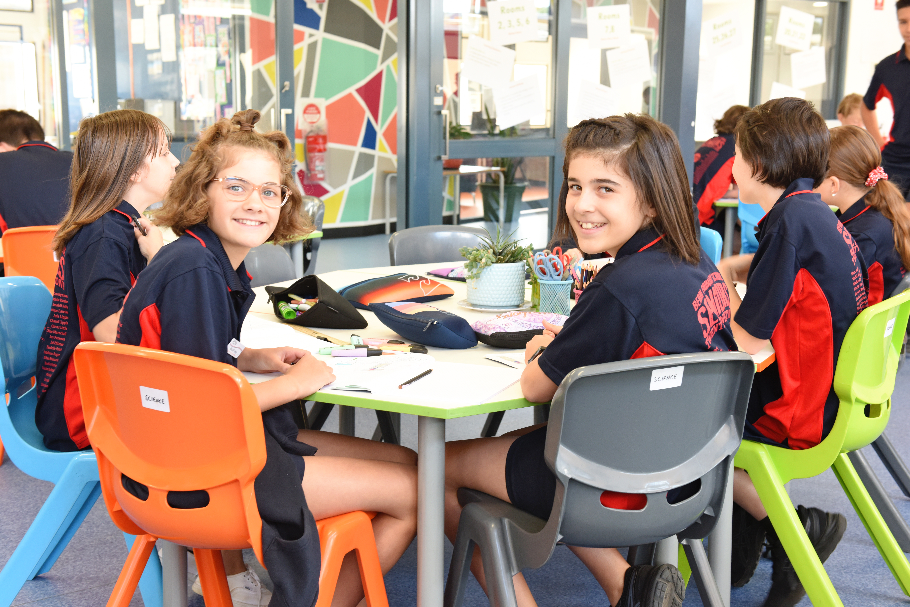
Bullying prevention at our school
Notes:
Notes:
Purpose of Slide 7 – To outline to parents the specific actions the school are undertaking to prevent and respond to bullying and build positive and inclusive relationships.
Action: Add your school name to the slide
Script - As a school, we are doing a range of things to help your children to:
Understand what bullying is and why it is never ok
Help develop relationships based on respect, kindness and inclusion
Talk about bullying openly and the role of the bystander in bullying
Feel comfortable to discuss any concerns with their teacher or trusted adult in the school to ensure this school is a safe and fun place to attend

Slide 8
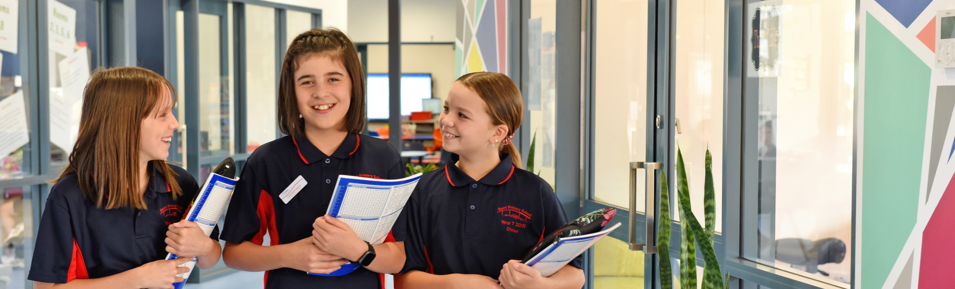
What your children are learning about bullying
What bullying is
The different types of bullying
Steps to take if your child is experiencing bullying
What your child can do if they are a bystander
Proactive ways to create positive environments to prevent bullying
Notes:
Notes:
Purpose for Slide 8 – To outline to parents what their children are learning about bullying and the practical skills they are practicing to build social skills and prevent bullying. Informing parents about the content covered will hopefully encourage parents to reinforce the knowledge and skills at home.
Script - Your children are learning
- What bullying is. This is based on the national definition you watched earlier.
About the different types of bullying (e.g. cyberbullying, covert bullying)
The steps to take if they experience bullying in the classroom, either on the school grounds or online
The steps your child can take if they are a bystander or see a bullying incident
The different things they can do to create positive and inclusive environments that prevent bullying
It is helpful that your child is receiving the same messages about bullying and building positive relationships at school and home.

Slide 9
What your children are learning about bullying
Australian Curriculum: Personal and Social Capability
Covers: Bullying prevention, conflict resolution, self-awareness and social awareness
Keeping Safe: Child Protection Curriculum
Healthy and respectful relationships, power in relationships, online safety
*OPTIONAL* Our school programs
Like peer support programs or the National Day of Action against Bullying and Violence social and emotional programs.
Notes:
Notes for presenter:
Purpose of slide 9 - To outline to parents what their children are learning about bullying and the practical skills they are practicing to build social skills and prevent bullying. Informing parents about the content covered will hopefully encourage parents to reinforce the knowledge and skills at home.
Script -
Action: In this section, populate this slide with the specific actions the school is taking to prevent bullying and create safe, positive and inclusive environments.
This may include:
National Day of Action against bullying and violence
Australian Curriculum which covers bullying prevention, conflict resolution, self-awareness and social awareness
Keeping Safe: Child Protection curriculum covers healthy and respectful relationship, the power dynamic in relationships and online safety
Social and emotional programs
Bullying Prevention lessons

Slide 10
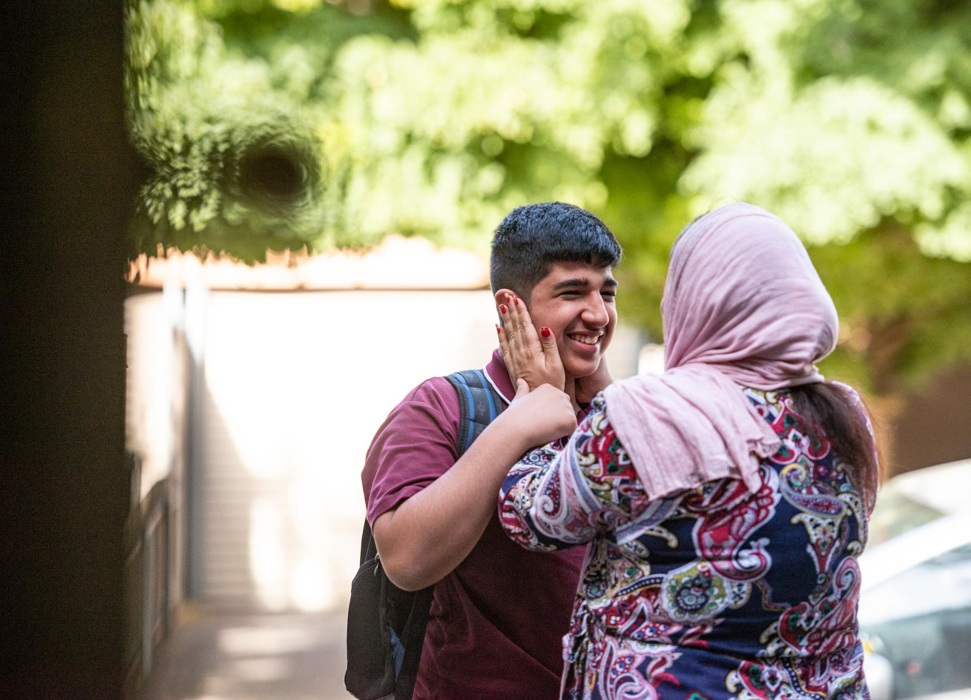
What parents can do for bullying prevention
Parents can reinforce:
What positive, healthy relationships look like and things we can do to build these friendships
The steps to take together if your child is involved in a bullying situation
The same understanding of what bullying is and what it is not
Open lines of communication between school, home and your child.
Notes:
Notes for presenter:
Purpose of Slide 10 – Outline to parents the specific things they can do to support their child in bullying prevention and response. We will also outline specific ways to reinforce supportive and inclusive behaviours to enhance continuity between home and school
Script - The school aims to work together with you, as parents to:
Provide a consistent message around what bullying is
And to:
Reinforce behaviours that are supportive and inclusive
So it is important that we are on the same page when in comes to preventing and responding to bullying. This includes:
Reinforcing the same understanding of what bullying is and what it is not
Reinforcing what positive, healthy relationships look like and the things your child can do to build these friendships
Knowing the steps to take together if your child is involved in a bullying situation
Opening the lines of communication between school, home and your child
Again this helps to support your children to develop positive social and emotional behaviours that are consistent between school and at home.

Slide 11
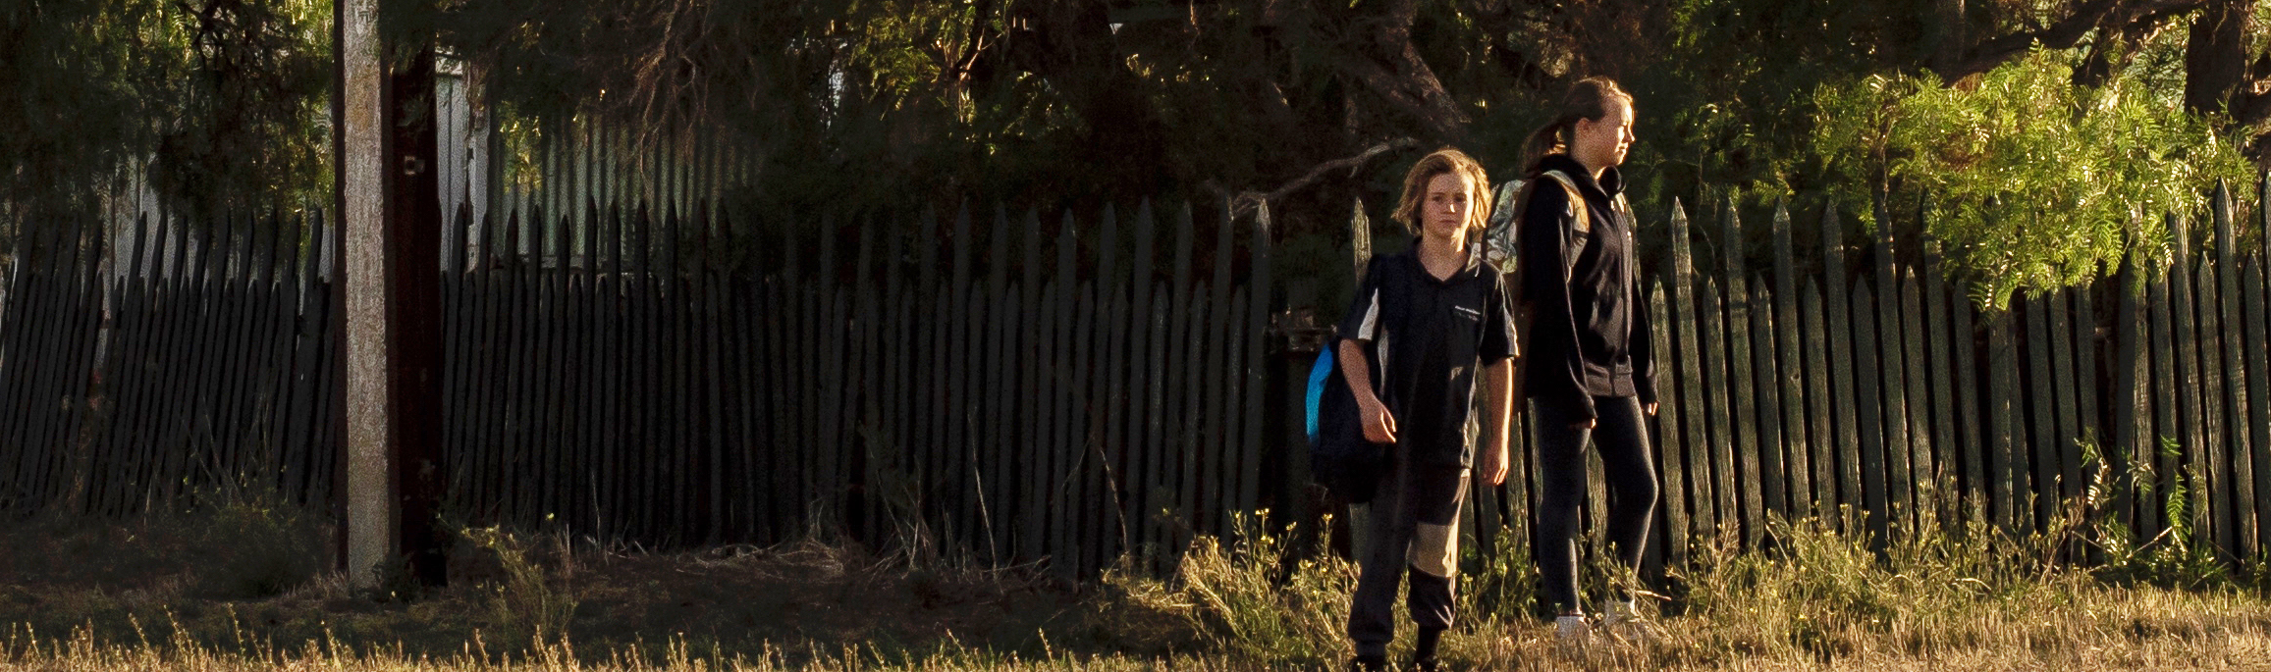
Spot these common signs
Changes in mood and usual behaviour (eg withdrawn, tired)
Change in method or routine to school
Frightened of catching the bus or walking to/from school
Unexplained bruises, cuts or scratches
Lost or damaged clothes or belongings
Arrive home hungry despite food being provided
Notes:
Notes for presenter:
Purpose of Slide 11 – Parents and teachers are best placed to recognise when a child or young person is experiencing issues. However, it is important not to presume that parents know the behaviours to look out for, so it is important to provide parents with some of the main indicators that suggest their child may be experiencing issues, one of which could be bullying,
Script – Changes in behaviour, mood or academic performance may be indications that your child may be experiencing issues, one of which could be bullying.
It is important to understand that these may be signs that something else may be happening for your child, but either way they are in need of further support.
At school we may see a child or young person:
become aggressive and argumentative
begin to get into altercations
appear more tired than usual
have unexplained absences or increased lateness
Isolate or withdraw from friends and activities they previously enjoyed
appearing insecure or frightened.
As parents, you may notice changes in your child’s behaviour at home which may indicate there may be an issue. This includes:
change their method or route to school
change sleep or eating patterns
drop in academic performance
be frightened of catching the bus or walking to school
take money from home
have unexplained bruises, cuts or scratches
lose or bring home damaged clothing or belongings
arrive home hungry despite food being provided.
It is important not to ignore these signs and open up the lines of communication with your child and the school

Slide 12
Clear and open communication in prevention
Schedule a time with classroom teacher or leader to talk about your concerns
Take some notes based on what your child has told you, or what you have observed, so you can be as clear as possible
Keep the lines of communication open
Notes:
Notes for presenter:
Purpose of Slide 12 – It is important that parents are aware the school is eager to partner with them to ensure their child has a positive experience at school and the school is a place where they can come if they are concerned about their child’s wellbeing.
It is also important that parents are provided clear guidance about how best to raise their concerns with the school to get the best result.
Script – Your concerns are important. So scheduling a time to talk with your child’s teacher or a school leader will make sure that a dedicated and focused time is available to discuss your concerns. Catching the teacher in the morning or after the day has ended may not give you or the school the best time and opportunity to communicate appropriately.
It is also a good idea to take some notes based on what your child has told you, or what you have observed, so you can be as clear as possible.
And again, keeping the lines of communication open with your child and school will ensure the situation is resolved positively

Slide 13

Zoe’s bullying story
Notes:
Notes for presenter:
Purpose of Slide 13 – Zoe’s story is a real-life example of a young person’s experience with bullying and how her family, the school and mental health professionals provided Zoe with wrap-around support. It is useful to provide a case study of how the school, outside mental health professional and family can successfully work together to prevent and respond to bullying, so parents feel assured they too, will receive this support.
Script – The following video, Zoe’s story is an example of how the school, families and mental health professional successfully worked together in bullying prevention and response. As a school, we are committed to providing wrap-around support to your child and family to ensure the school is a positive and safe place for all to belong.

Slide 14
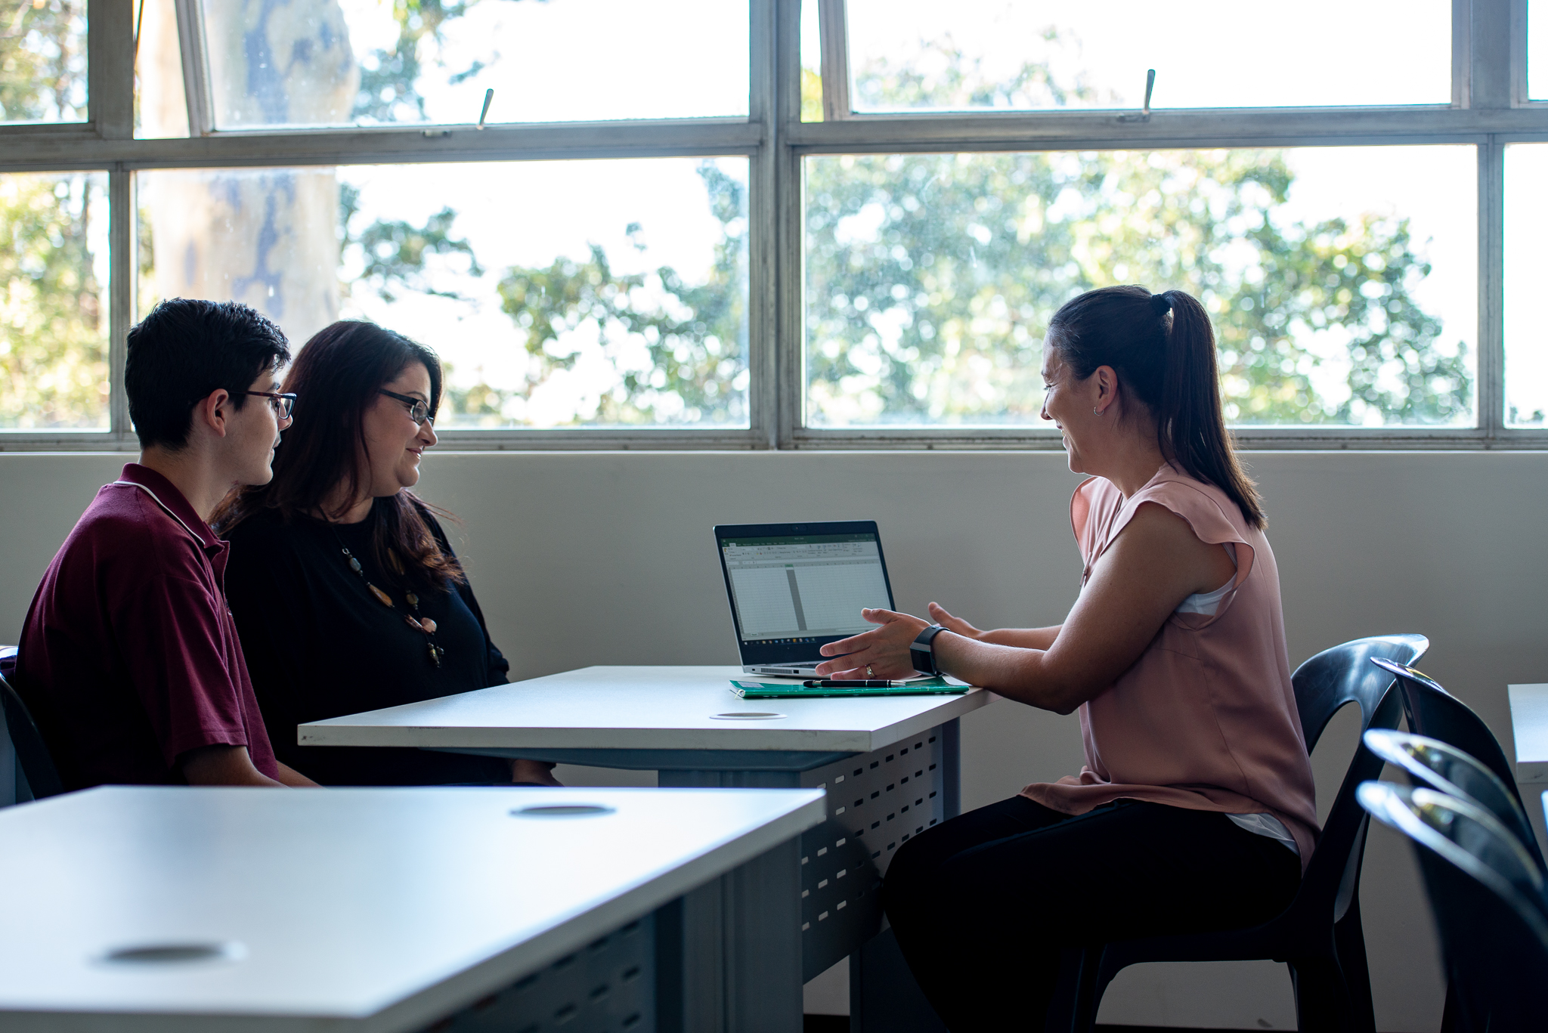
How the school will respond to bullying
Notes:
Notes for presenter:
Purpose of Slide 14 – Clearly outlining the school’s response and policy regarding bullying prevention and response will reinforce to parents that bullying prevention and response is taken seriously 1) within the curriculum 2) throughout the school culture and 3) in school-wide response
Script – As a school, we have committed to a school-wide approach to preventing and responding to bullying.
*Reiterate specific actions the school is taking to prevent bullying and create safe, positive and inclusive environments. E.g. Buddy programs, restorative practice

Slide 15
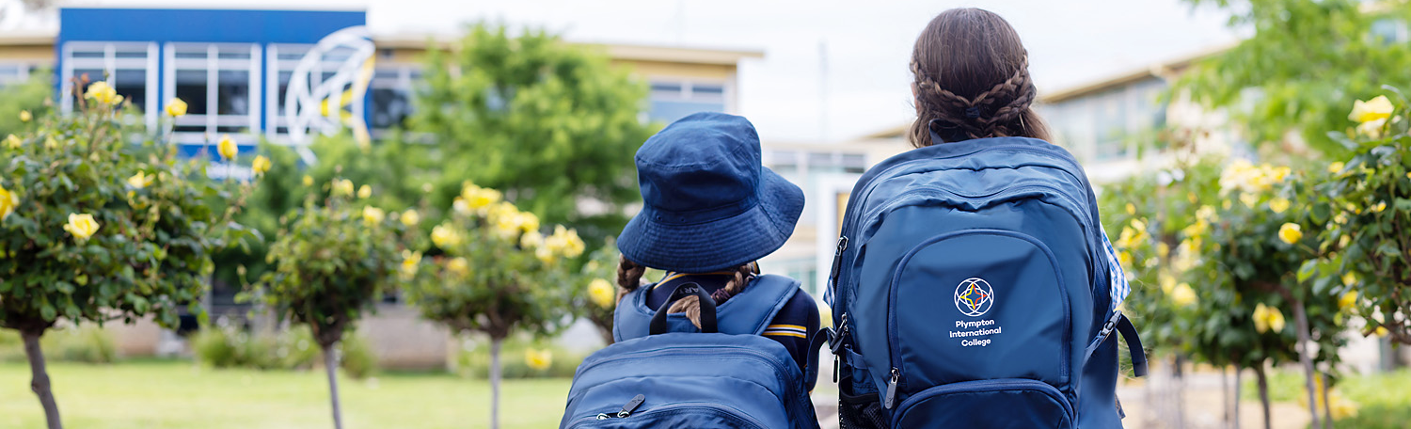
Our school’s bullying prevention policy
Put a copy of your Bullying Prevention Policy and where it can be found on your website
Notes:
Notes for presenter:
Purpose of Slide 15 - To make parents aware of where the bullying prevention policy lives on the school website and that the school is committed to preventing and responding to bullying in a timely and supportive way.
Action: add your school name to this slide, along with a copy of your bullying prevention policy
Script – We have outlined our commitment to Bullying Prevention and response in our school’s Bullying Prevention Policy, which can be found on our website. Our policy outlines:
Our commitment to bullying prevention
The specific ways we, as a school community aim to create a safe and inclusive environment that your child wants to be a part of
How we intervene in bullying incidents and repair and restore relationships
Our Bullying Prevention Policy outlines
the process to report incidents of bullying to the school
who in the school is best positioned to provide support
the different ways you can connect with us at the school
We endeavour to work together toward building safe environments that promote positive relationships, safety and wellbeing so that your child can achieve their full potential.

Slide 16



Helpful resources about bullying
Department for Education – Bullying Prevention Strategy
Bullying. No Way!
Reachout.com
eSafety Commissioner
Notes:
Notes for presenter:
Purpose of Slide 16 - To provide parents with other resources, information and support they can access around Bullying prevention, response and cybersafety
Script – There are various sources of information available to you as parents:
The Department for Education parent resources
Bullying. No Way! provides a suite of resources for both parents and your children
Reachout.com
eSafety Commisssioner

Slide 17
Bullying prevention and response
Notes:
Notes for presenter:
Purpose of Slide 17 - To conclude the presentation and invite any questions
Script – Thank you for coming today/tonight and being willing to partner with the school to provide a supportive and inclusive school environment.
I would like to invite any questions or queries. *Allow for time for parents to ask questions if appropriate
Alternatively, if any you have any further questions or would like to talk further…
*Indicate the best person/s and the best way to connect with the school.

