Slide 1
Australian Early Development Census (AEDC)
2021 Preliminary School Snapshot- FAQs
Notes:
Picture:

Slide 2
What is the purpose of the snapshot?
Release of preliminary raw data to schools is being trialled during the 2021 AEDC collection, in a Preliminary School Snapshot
Earlier access to indicative data can:
give schools an immediate indication of the final results
signal how children are tracking in relation to school curriculum and priorities
give schools a head start in thinking about what is needed to support improved learning, development and wellbeing of the current cohort of students and those starting in 2022

Slide 3
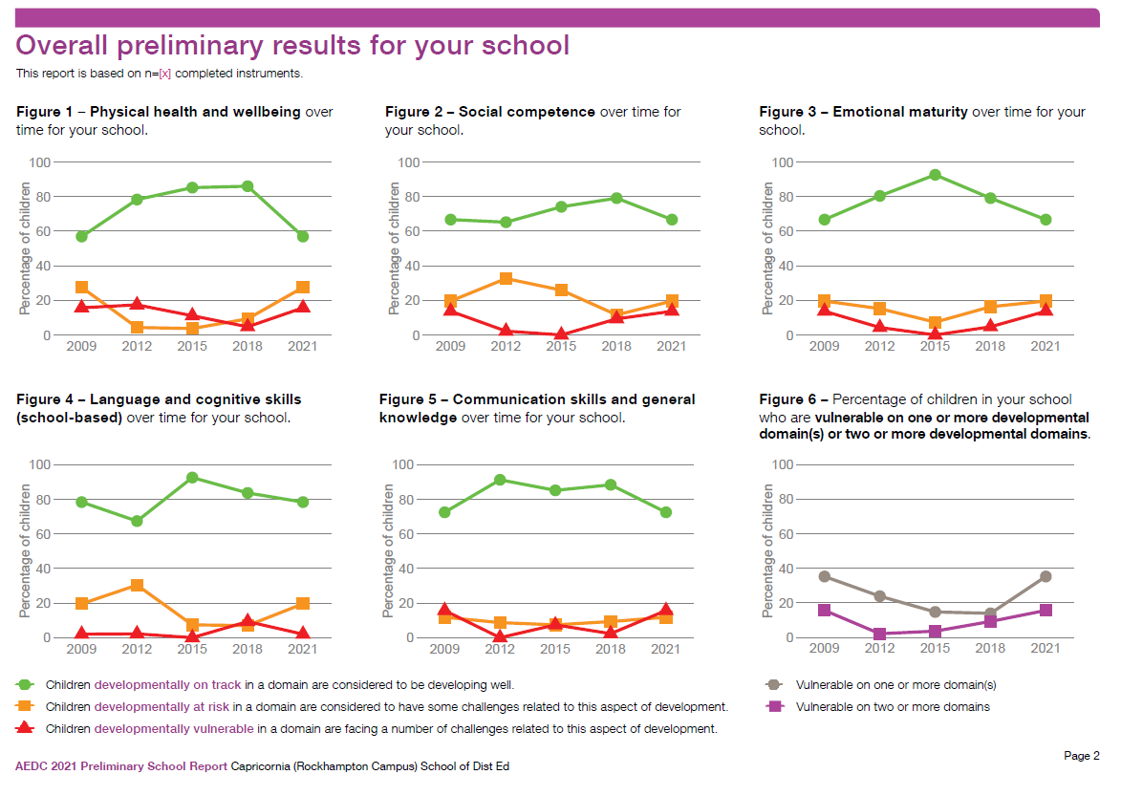
What does the snapshot look like?

Slide 4
What does the snapshot tell schools?
The snapshot shows:
an overview of children’s development across the five AEDC domains
data for the two summary indicators of developmental vulnerability in 1 or more or 2 or more domains
trends in results for cohorts of children over time but not exact percentages

Slide 5
Is the aedc data important?
Yes. AEDC data can:
indicate what is going well and where children and families may need more support
guide schools in developing local partnerships with community agencies to support children and families to engage in and benefit from what the school offers

Slide 6
How can schools use the snapshot?
Use the snapshot as an indication of how children’s development has been supported over time
Look at changes between collections and consider
factors that:
have shaped children’s development in the community to date (family, community and ECEC experiences)
continue to shape and impact children’s engagement in learning and social opportunities at school
might impact parent and community engagement in ECEC, school and services

Slide 7
What are the benefits of using AEDC data?
Using AEDC data can:
increase awareness of children’s needs in the community and their contexts
inform transition to school plans
inform continuity of learning and curriculum plans that build on children's capacities
identify challenges of practice
measure success
help meet standards: NQS, EYLF, AITSL, curriculum
be used as evidence for grant applications
Follow these links to see what schools are doing with their AEDC results
School stories
Inform local partnerships
Curriculum planning

Slide 8
When will the final 2021 results arrive?
NOW
Preliminary School Snapshot
MAR 22
National 2021 AEDC results
NOV 21
Final School Profile
Community profiles
Addendums of school trend results compared to the rest of SA and Australia

Slide 9
What do I need to remember about the snapshot?
Snapshot data has not been subjected to data cleaning
Changes in data for small groups of children may appear as large fluctuations over time and in the proportion of children
The snapshot is considered an indicator
The November 2021 School Profile will present:
finalised data, which may differ slightly
contextual and community data
Used in parallel with other data sources and information, AEDC data can:
provide insights into children’s holistic development and their experiences of starting school
inform longer term planning

Slide 10
Where can I learn more about using aedc data effectively?
Go to the Department for Education, Australian Early Development Census website for more information, resources and to access the AEDC professional learning program
Knowing how children are developing when they start school can help identify community strengths, challenges and opportunities to ensure education and care planning is responsive and inclusive of children’s experiences, strengths, development and learning needs

Slide 11
Do you have a question?
Want to find out more about your data?
Interested in hosting a tailored session about the AEDC and your data?
Who can I contact if I have questions?
Contact:
Myléne Warman, State Coordinator, Australian Early Development Census, Department for Education
T: 8226 1064 │ M:0429930787 │ Mylene.warman@sa.gov.au │ Education.AEDCteam@sa.gov.au │ Department for Education AEDC for schools and ECEC│ www.aedc.gov.au

